Slide 2
J EE 5: Web Component Development

Slide 3
Day 1

Slide 4
Day – 1 Coverage
Java Servlet Technology
J2EE Overview
Building a Servlet
HTTP Basics
Servlet API
Servlet Life Cycle
Servlet Objects
Exceptions and Errors
4

Slide 5
J2EE Overview
What Is the J2EE?
Open and standard based platform for
developing, deploying and managing
n-tier, Web-enabled, server-centric, and component-based enterprise applications

Slide 6
J2EE Overview
What Makes Up J2EE?
API and Technology specifications
Development and Deployment Platform
Standard and production-quality implementation
Compatibility Test Suite (CTS)

Slide 7
J2EE Overview
Evolution of Enterprise Application Framework
Single tier
Two tier
Three tier
RPC based
Remote object based
Three tier (HTML browser and Web server)
Proprietary application server
Standard application server

Slide 8
J2EE Overview
About Enterprise Applications
Things that make up an enterprise application
Presentation logic
Business logic
Data access logic (and data model)
System services
The evolution of enterprise application framework reflects
How flexibly you want to make changes
Where the system services are coming from

Slide 9
J2EE Overview
Open and Standard Solution
Use "component and container" model in which container provides system services in a well-defined and as industry standard.
J2EE is that standard that also provides portability of code because it is based on Java technology and standard-based Java programming APIs

Slide 10
J2EE Overview
Platform Value to Developers
Can use any J2EE implementation for development and deployment
Use production-quality standard implementation which is free for development/deployment
Use high-end commercial J2EE products for scalability and fault-tolerance
Vast amount of J2EE community resources
Many J2EE related books, articles, tutorials,quality code you can use, best practice guidelines, design patterns etc.
Can use off-the-shelf 3rd-party business components

Slide 11
J2EE Overview
Platform Value to Vendors
Vendors work together on specifications and then compete in implementations In the areas of Scalability, Performance, Reliability, Availability, Management and development tools, and so on
Freedom to innovate while maintaining the portability of applications

Slide 12
J2EE Overview
Platform Value to Business Customers
Application portability
Many implementation choices are possible based on various requirements
Price (free to high-end), scalability (single CPU to clustered model), reliability, performance, tools, and more
Best of breed of applications and platforms
Large developer pool

Slide 13
J2EE 1.4 and JEE 5 APIs and Technologies
J2EE 1.4
J2SE 1.4 (improved)
JAX-RPC (new)
JMX
JMS
JTA
Servlet 2.4
JSP 2.0
EJB 2.1
JAXR
Connector 1.5
JACC
JAXP 1.2
JavaMail
JAF ,etc
Java EE 5
JAX-WS 2.0 & JSR 181
Java Persistence
EJB 3.0
JAXB 2.0
JavaSever Faces 1.2 – new to Platform
JSP 2.1 – Unification w/ JSF 1.2
StAX – Pull Parser – new to Platform
Servlet 2.5
JSP 2.1
Java Mail
JAF
JMS
JTA , etc
13
Notes:
13

Slide 14
J2EE Overview
Containers and Components
Containers do their work invisibly
No complicated APIs
Containers implement J2EE
Look the same to components
Vendors making the containers have great freedom to innovate

Slide 15
J2EE Overview
J2EE Development Roles
Component provider
Bean provider
Application assembler
Deployer
Platform provider
Container provider
Tools provider
System administrator

Slide 16
J2EE Overview
Deployment Descriptor
Gives the container instructions on how to manage and control behaviors of the J2EE components
Transaction
Security
Persistence
Allows declarative customization (as opposed to programming
customization)
XML file
Enables portability of code

Slide 17
J2EE Overview
An application server is a software engine that delivers applications to client computers or devices. Moreover, an application server handles most, if not all, of the business logic and data access of the application

Slide 18
J2EE Overview
Features
Application server products typically bundle middleware to enable applications to intercommunicate with dependent applications, like Web servers, database management systems and chart programs.
Portals are a common application server mechanism by which a single point of entry is provided to multiple devices.
EJB are hosted in an Application Server. Some common example of Application Server are WebSphere Application Server ( ), JBoss (RedHat), Tomcat (Apache), SunAppServer( Sun Microsystems), WebLogic Server (BEA).

Slide 19
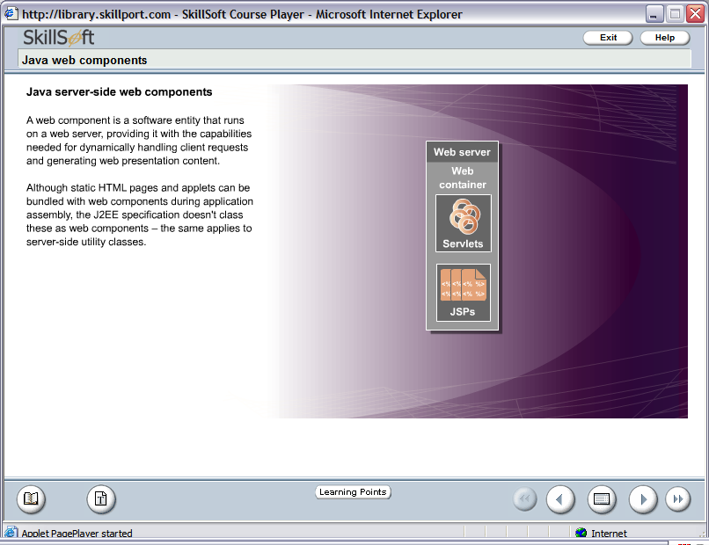
What is a Web Component?
A web component is a software entity that runs on a web server, providing it with the capabilities needed for dynamically handling client requests and generating web presentation content.
19

Slide 20

Building a Servlet
A java program that is responsible for generating dynamic content and interacting with Web clients using a request-response paradigm.
What is a Servlet?
20
Notes:
20

Slide 21
Building a Servlet
Features of Servlet
Security : Inherits the security feature provided by the container.
Session Management : Maintains the identity and state of an end user across multiple requests.
Instance Persistence : Enhances the performance of the server by preventing frequent disk access.
Platform and server independent.
Available and running on all major web servers and application servers.
21
Notes:
21
1. Security: A Web container provides a runtime environment for executing a
servlet. Servlets inherit the security feature provided by the Web container. This
allows developers to focus on the servlet functionality and leave the security
issues to the Web container to handle.
2. Session management: It is the mechanism of tracking the state of a user across
multiple requests. A session maintains the client identity and state across
multiple requests.
3. Instance persistence: Servlets help to enhance the performance of the server by
preventing frequent disk access. For example, if a customer logs on to an online
banking site, the customer can perform activities, such as checking for the
balance or applying for a loan. The account number of the customer will be
validated at every stage from the database. Instead of every time checking the
account number against the database, servlets retain the account number in the
memory till the user logs out of the Web site.

Slide 22
Building a Servlet
J2EE Application Server
Web Container
Request
Servlet
Web Client (Browser)
Response
22
Notes:
22
Features of CGI:-
Written in C, C++, VB and Perl language.
Resource intensive and inefficient.
Difficult to maintain, non-scalable, non-manageable.
Platform and application specific.
Features of Servlets:
Written in Java.
Powerful, reliable and efficient.
Improves Scalability.
Platform independent and portable.

Slide 23
Building a Servlet
J2EE Application Server
Web Container
Loads The Servlet class
First Client Request
Instantiates the Servlet
Initializes the Servlet Instance
Passes request to the Servlet Instance
Sends Response
23
Notes:
23
Working of Servlets
Whenever a client sends a request to the J2EE application server for a particular
servlet, the J2EE application server passes the request to the Web container. The Web
container checks whether an instance of the requested servlet exists. If the servlet
instance exists then the Web container delegates the request to the servlet, which
process the client request and sends back the response.
In case the servlet instance does not exist, the Web container locates and loads the
servlet class. The Web container then creates an instance of the servlet and initializes
it. The servlet instance, after initialization, starts processing the request. The Web
container passes the response generated by the servlet to the client.

Slide 24
Building a Servlet
Enterprise
Information
System
Server-Side
Presentation
Server-Side
Business Logic
Browser
Web Server
EJB
Container
Pure HTML
JSP
EJB
Java Applet
Java Servlet
EJB
Desktop
Java Application
J2EE Platforms
J2EE Platforms
Other Device
J2EE Client
Web Tier
EJB Tier
24
Notes:
24
EIS are the different database systems like Oracle, DB2, SQL Server.

Slide 25
HTTP Basics
HTTP Basics
The Hypertext Transfer Protocol (HTTP) is an application-level protocol with the lightness and speed necessary for distributed, collaborative, hypermedia information systems.
It is a generic, stateless, object-oriented protocol which can be used for many tasks, such as name servers and distributed object management systems, through extension of its request methods (commands).
25
Notes:
Tim Berners-Lee implemented the HTTP protocol in 1990-1 at CERN, the European Center for High-Energy Physics in Geneva, Switzerland.

Slide 26
HTTP Basics
26
HTTP Basics (Contd.)
HTTP (Hyper Text Transfer Protocol) is one of the numerous protocols, which computers use, to talk to each other (just the same way two human beings need a common language to communicate).
When a computer initiates a connection to another computer, in HTTP jargon, it is a request.
When the server computer sends data back, it is a response.

Slide 27
HTTP Basics
HTTP Basics
An HTTP request has also three parts:
A request line
One or more request headers
A message
A request line looks like:
GET /WelcomeProject/Home.html HTTP/1.1
1st token is the name of the method, in this case it is GET The
2nd token is the URI, that gives information about the location of the
resource to be gotten.
The last token is the version of HTTP to be used.
27
Notes:
27
Other Methods are – POST, PUT, DELETE, HEAD
URI stands for Uniform Resource Identifier. URI gives information about the location of the resource to be gotten.

Slide 28
HTTP Basics
HTTP Response
An HTTP response has three parts
A response line
One or more response headers
A message
A response line looks like:
HTTP/1.1 200 OK
1st token is the HTTP version.
2nd token is one of the many predefined status codes.
3rd token is an English description of the status code.
28
Notes:
28
URI stands for Uniform Resource Identifier. URI gives information about the location of the resource to be gotten.

Slide 29
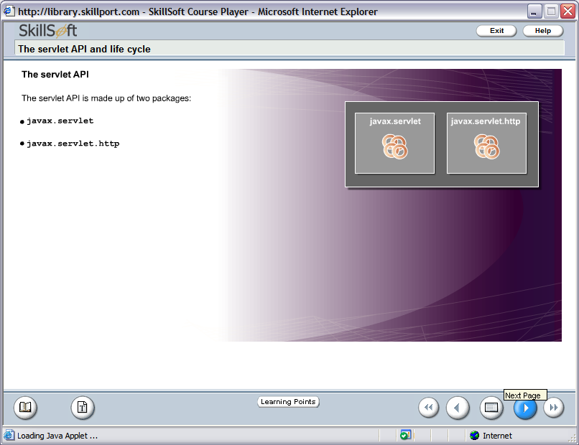
Servlet API
The servlet API is made up of two packages
1.
javax.servlet
2.
javax.servlet.http
29

Slide 30
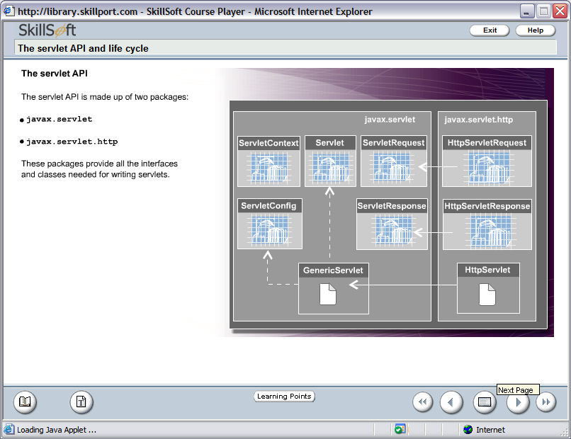
Servlet API
The servlet API is made up of two packages
1.
javax.servlet
2.
javax.servlet.http
30

Slide 31
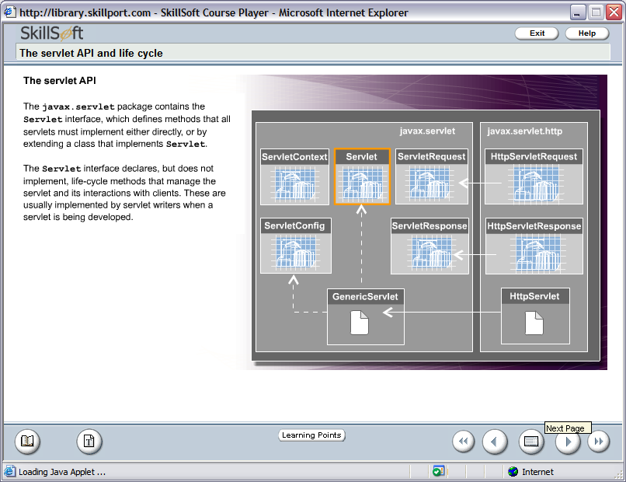
Servlet API
The servlet API is made up of two packages
1.
javax.servlet
Servlet Interface, which
defines methods that all
servlets must implement
either directly, or by
extending a class that
implements Servlet.
It does not implement the
life cycle methods.
31

Slide 32
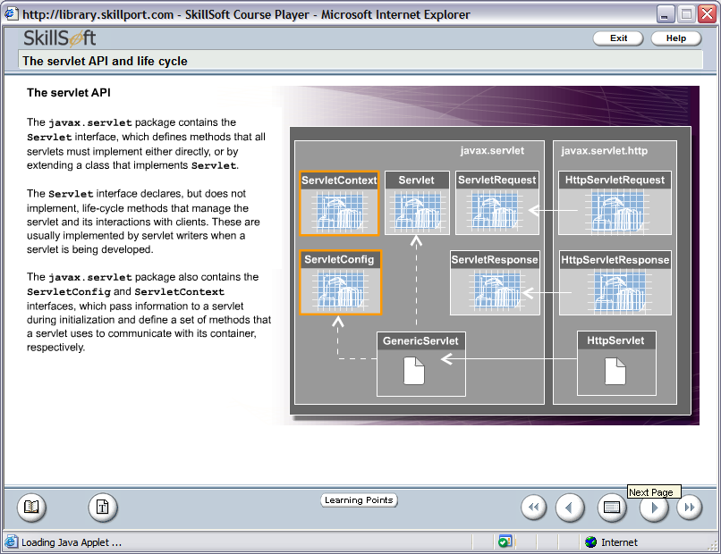
Servlet API
The servlet API is made up of two packages
1.
javax.servlet
ServletConfig interface
pass information to a
servlet during initialization.
ServletContext interface
define a set of methods
that a servlet uses to
communicate with its
container.
32

Slide 33
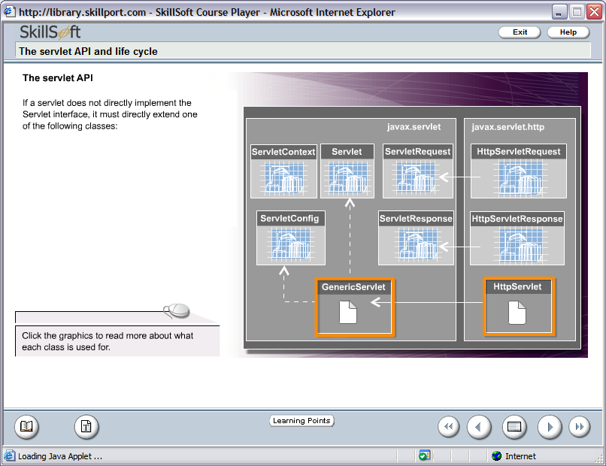
Servlet API
If a servlet does not directly implement the Servlet interface, it must directly extend the following classes:
1.
GenericServlet
2.
HttpServlet
33

Slide 34
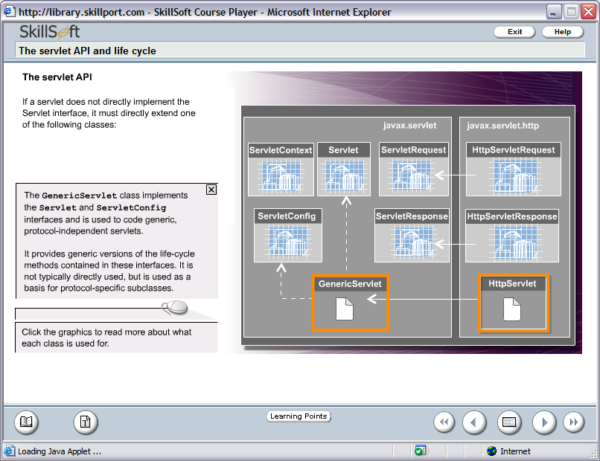
Servlet API
1.
GenericServlet
It is used to code generic,
protocol-independent
servlets.
It is used as the basis for
protocol-specific subclasses.
34

Slide 35
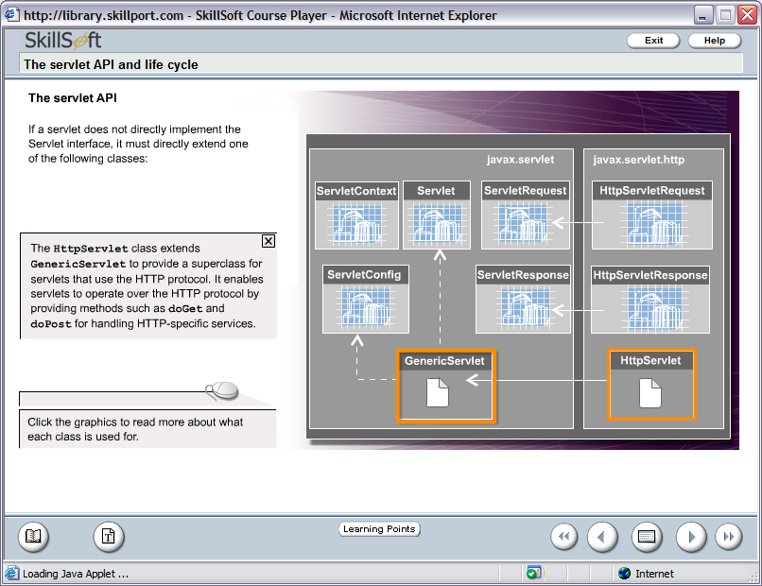
Servlet API
2.
HttpServlet
HttpServlet class enables to
operate over the HTTP
protocol by providing
methods such as doGet and
doPost for handling HTTP-
specific services.
35

Slide 36
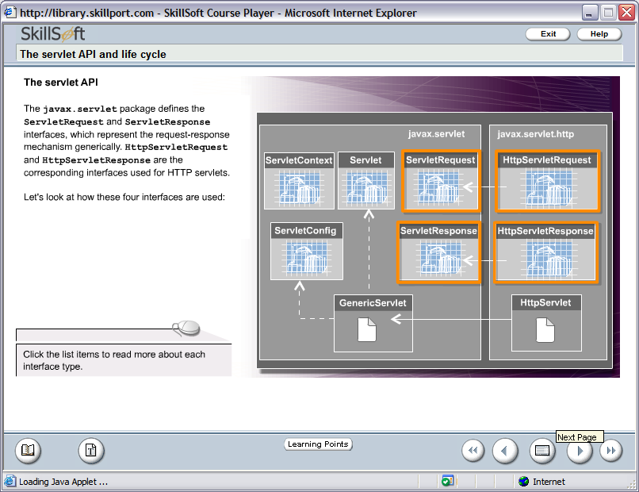
Servlet API
Request-Response API’s
1.
ServletRequest
2.
HttpServletRequest
3.
ServletResponse
4.
HttpServletResponse
36

Slide 37
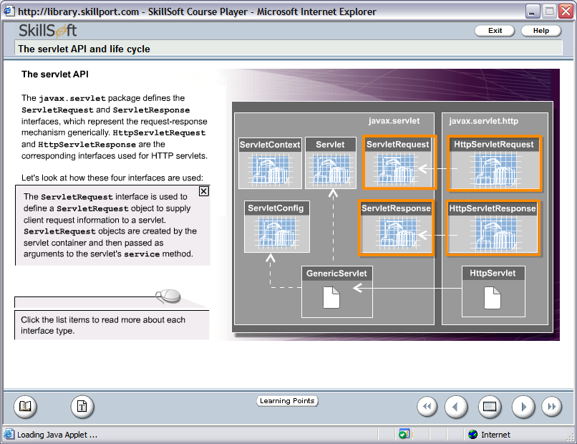
Servlet API
1.
ServletRequest
ServletRequest Interface
object is used to supply
client request information to
a servlet.
It is created by the servlet
container and then passed
arguments to the servlet’s
service method.
37

Slide 38
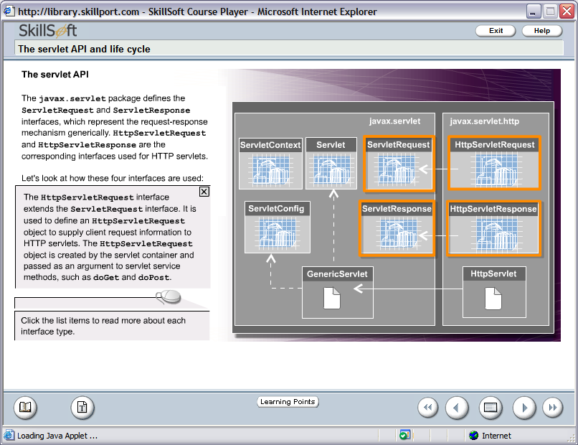
Servlet API
2.
HttpServletRequest
HttpServletRequest
Interface object is used to
supply client request
information to HTTP
servlets.
It is created by the servlet
container and then passed
arguments to the servlet’s
service method, such as
doGet and doPost.
38

Slide 39
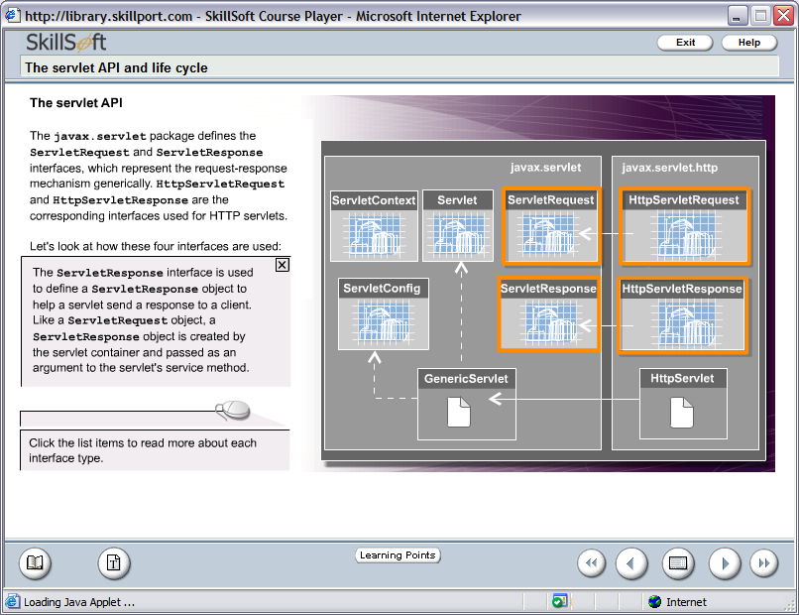
Servlet API
3.
ServletResponse
ServletResponse
Interface object help a
servlet send a response to
a client.
It is created by the servlet
container and then passed
arguments to the servlet’s
service method.
39

Slide 40
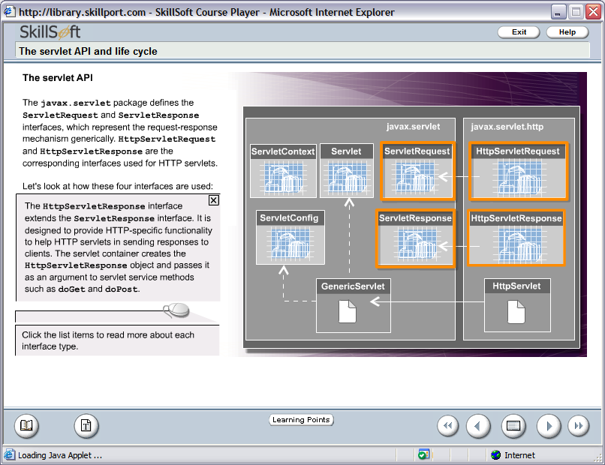
Servlet API
4.
HttpServletResponse
HttpServletResponse
Interface object is designed
to provide HTTP-specific functionality to help HTTP servlets in sending responses to clients.
It is created by the servlet
container and then passed
arguments to the servlet’s
service method such as
doGet and doPost.
40

Slide 41
Servlet Creation
Steps to create standard packaging structure of a web application, create the following directories:
A root directory – It contains the static resources, such as, HTML, JSP and image files.
A WEB-INF directory – Resides inside the root directory. It contains the web.xml file that stores various configurations of a web application.
A classes directory – Resides under the WEB-INF directory and contains the class files of the application.
A lib directory – It also resides under the WEB-INF directory and contains JAR files.
41

Slide 42
Servlet Creation
Packaging the servlet
J2EE defines a standard packaging structure to package a servlet into a J2EE application to make it portable across different application servers.
A standard packaging structure will allow application servers to easily locate and load application files from the standard directory structure.
In most of the cases, the standard packaging structure is created by the Integrated Development Environment in use like, RAD, MyEclipse, WSAD, SunAppServer.
42

Slide 43
Directory structure of a Web Application
Root Directory
Page1.htm
WEB-INF
web.xml
classes
WelcomeServlet.class
lib
43

Slide 44
Deployment Descriptor
The web.xml consists of :-
XML Prolog information.
Web Application display name.
Servlet Information.
Servlet Display Name.
Name of the Servlet, when it will be accessed.
Servlet Class Name.
URL Mappings.
Welcome files.
MIME types.
44
Notes:
44

Slide 45
Content of web.xml
web.xml – Deployment Descriptor
<?xml version=“1.0” encoding=“UTF-8” ?>
<web-app version=“2.4” xmlns=“http://java.sun.com/xml/ns/j2ee” xmlns:xsi=“http://www.w3.org/2001/XMLSchema-Instance xsi:schemaLocation=“http://java.sun.com/xml/ns/j2ee http://java.sun.com/xml/ns/j2ee/web-app_2_4.xsd”>
<display-name>WelcomeApplication</display-name>
<servlet>
<display-name>WelcomeServlet</display-name>
<servlet-name>WelcomeServlet</servlet-name>
<servlet-class> .sample.WelcomeServlet</servlet-class>
</servlet>
<welcome-file-list>
<welcome-file>WelcomeServlet</welcome-file>
</welcome-file-list>
<servlet-mapping>
<servlet-name>WelcomeServlet</servlet-name>
<url-pattern>/WelcomeServlet</url-pattern>
</servlet-mapping>
</web-app>
45

Slide 46
1. Creating a HTML Page – UserInfo.html
WebContextRoot
<html>
<title>Information Page</title>
<body>
<h1>User Information Page</h1>
<hr color=‘blue’ size=5>
<form action=“http://localhost:9080/WelcomeUserApplication/WelcomeUser”>
<pre>
Enter Your First Name : <input type=“text” name=“fname”>
Enter Your Last Name : <input type=“text” name=“lname”>
<input type=“submit” value=“Submit”> <input type=“reset” value=“Clear”>
</form>
</pre>
</body>
</html>
Servlet Alias Name
46
Notes:
46
Description of URL http://localost:9080/WelcomeUserApplication/WelcomeUser –
The port number specified is pertaining to RAD6.0 IDE with WebSphere Application Server6.0.
WelcomeUserApplication is the name of the WAR Module Project.
WelcomeUser is the name of the Servlet.
By default, the form method=“get”, so no need to specify.
Action attribute of <form> tag specify that which server side program will take care of the form elements data.

Slide 47
2. Creating a Servlet – WelcomeUser.java
package .sample;
import java.io.*;
import javax.servlet.*;
import javax.servlet.http.*;
public class WelcomeUser extends HttpServlet {
public void doGet(HttpServletRequest request, HttpServletResponse response)
throws IOEXception, ServletException
{
String firstname = request.getParameter(“fname”);
response.setContentType(“text/html”);
PrintWriter out = response.getWriter();
out.println(“<h1>Welcome ! <font color=‘blue’>“+firstname+”</font></h1>”);
}
Reads data from a text box as String
47
Notes:
47
getParameter() method is used to read data from a request object as String.

Slide 48
3. Save The Servlet
Click on Save button in the RAD IDE, if it display some red cross marks in your code then correct it and then save to generate a .class file.
4. Deploy the Servlet
Deploy the web module containing WelcomeUser Servlet. Right click on the WelcomeUser.java and select Run -> Run on Server and respond to the dialog box that will follow.
48

Slide 49
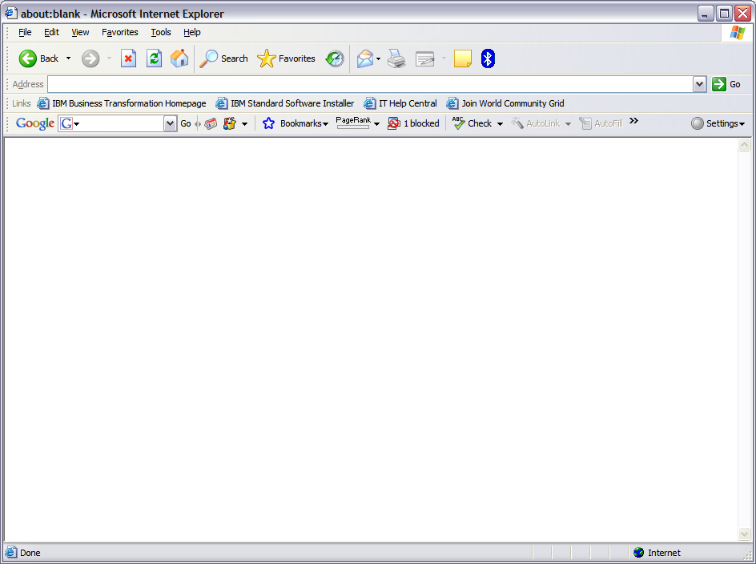
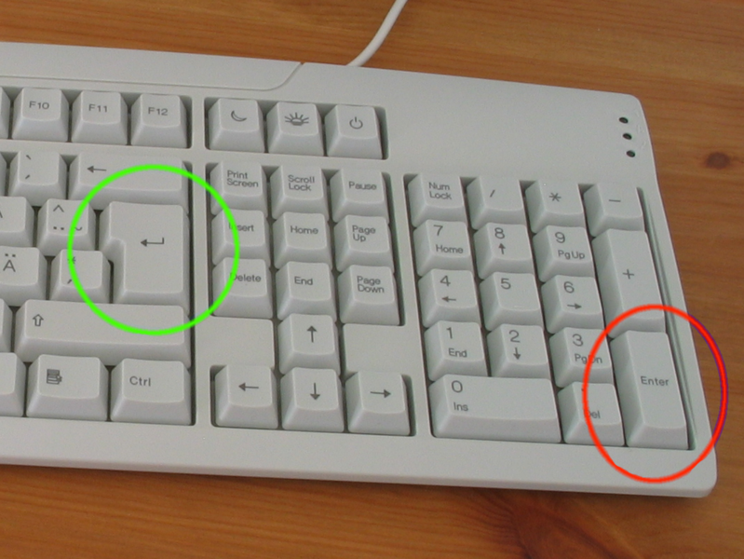
5. Access the HTML page in the Web Browser
Open the web browser and type
http://localhost:9080/WelcomeUserApplication/UserInfo.html
49

Slide 50
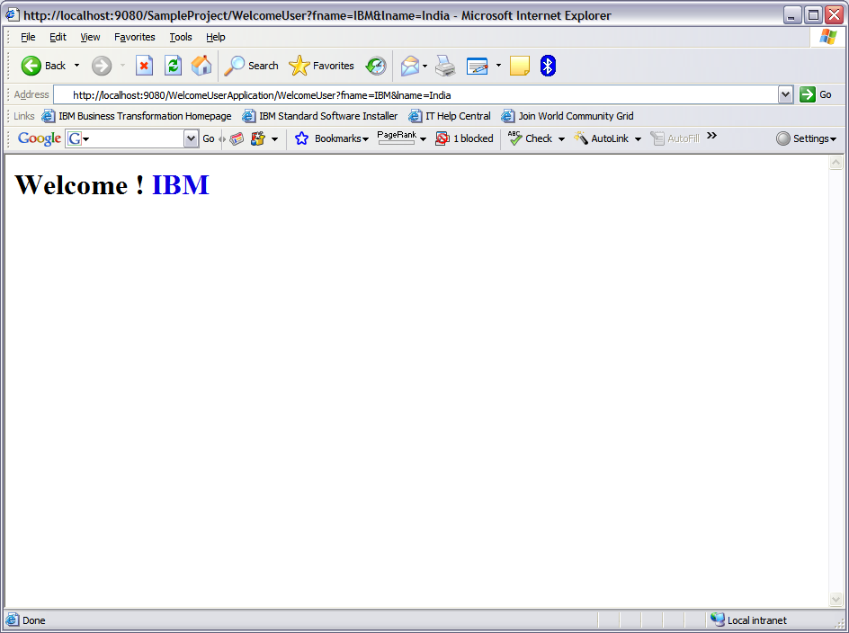
5. Access the HTML page in the Web Browser
http://localhost:9080/WelcomeUserApplication/WelcomeUser?fname= &lname=India
50

Slide 51
Life Cycle of an Servlet
A servlet’s life cycle is controlled using the methods shown in the diagram.
Does Not Exist
destroy()
init()
Initialized
service()
Servicing Requests
doXXX()
51

Slide 52
Life Cycle of an Servlet (Contd.)
The init method is invoked only once during the servlet’s life lifetime – when the servlet is first created. Each subsequent request generates a thread that calls the service method of the previously created instance.
The main task of the init() method is to allow the servlet to access deployment – specific initialization parameters, such as database settings.
Does Not Exist
destroy()
init()
Initialized
service()
Servicing Requests
doXXX()
52

Slide 53
Life Cycle of an Servlet (Contd.)
Every time the server receives an incoming request for a servlet, it generates a new thread and calls the service(). The service() method then checks the HTTP request type and calls the appropriate doXXX() methods.
Does Not Exist
destroy()
init()
Initialized
service()
Servicing Requests
doXXX()
53

Slide 54
Life Cycle of an Servlet (Contd.)
The doXXX() methods are where the bulk of the programming in a servlet takes place.
The doGet() method contains the code that enables that servlet to respond to clients that make requests via the URL.
The doPost() method enables the servlet to receive any data sent by the client as part of an input stream. This is typically form data.
Does Not Exist
destroy()
init()
Initialized
service()
Servicing Requests
doXXX()
54

Slide 55
Life Cycle of an Servlet (Contd.)
A server may unload a servlet instance if its running incorrectly, or if the servlet has been idle for some time. Before it removes the servlet, it calls the destroy() method. This provides the servlet with the opportunity to perform cleanup operations such as closing database connections, writing cookie lists, and halting background threads before it is destroyed.
Does Not Exist
destroy()
init()
Initialized
service()
Servicing Requests
doXXX()
55

Slide 56
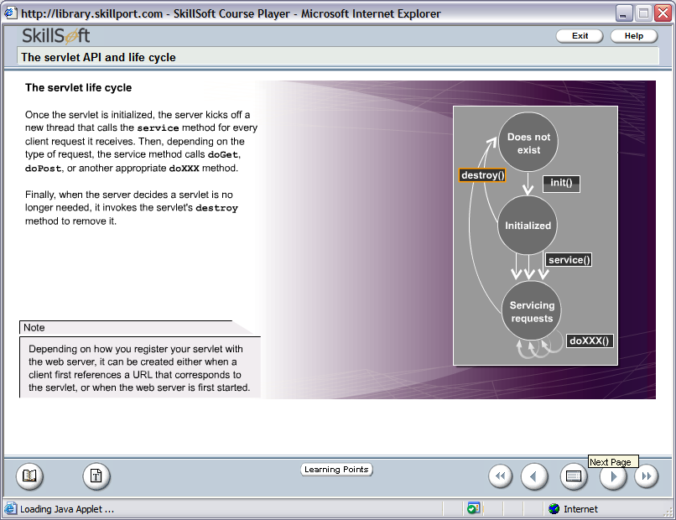
Life Cycle of an Servlet (Contd.)
Note
Depending on how you register your servlet with the web server, it can be created either when a client first references a URL that corresponds to the servlet, or when the web server is first started.
56

Slide 57
Servlet Object
Enables sharing information among collaborating web components via
attributes maintained in scope objects.
Attributes are name / object pairs.
Attributes maintained in the Scope objects are accessed with
getAttribute() and setAttribute() method.
There are Three (3) Scope Objects
1.
WebContext
(ServletContext)
Belongs to
javax.servlet.ServletContext
2.
Session
Belongs to
javax.servlet.http.HttpSession
3.
Request
Belongs to
javax.servlet.ServletRequest
57
Notes:
57
Web Context (ServletContext) – Accessible from web components within a web context.
Session – Accessible from web components handling a request that belongs to the session.
Request – Accessible from web components handling the request.
Can be discussed in context to JSP – The fourth type of Scope Object - Page – Accessible from JSP page that creates the object.

Slide 58
Servlet Context
Servlet Context
Shared by all servlets and JSP pages within a “web application”.
There is one ServletContext object per “web application” per JVM.
Set and get context-wide (application-wide) object valued attributes.
Access web context-wide initialization parameters set in web.xml file.
Access web resources associated with the Web Context.
The ServletContext is contained in ServletConfig object, which the web
server provides to a servlet when the servlet is initialized.
Used in logging the events.
58
Notes:
58
Web Application – A web application is a collection of servlets and content installed under a specific subset of the server’s URL namespace and possibly installed via a *.war file. Logging can be done using getServletContext().log(“some message”);

Slide 59
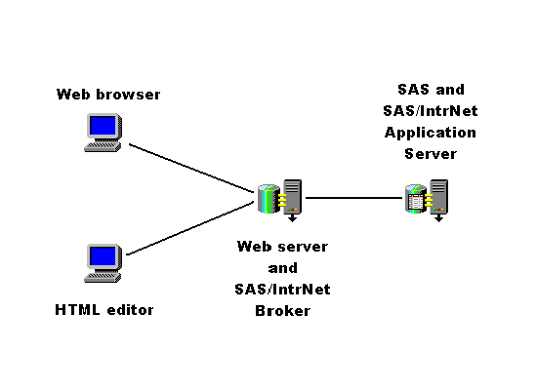
Scope of Servlet Objects.
ServletContext
Client 1
Application
Client 2
59
Notes:
59

Slide 60
Scope of Servlet Objects (Contd.)
Servlet Interface Methods
Method Name | Description
public ServletConfig getServletConfig() | Returns a ServletConfig object that contains configuration information, such as initialization parameters, to initialize a servlet.
public String getServletInfo() | It returns a string that contains information about the servlet, such as author, version, and copyright.
60
Notes:
60

Slide 61
Scope of Servlet Objects (Contd.)
ServletContext Interface Methods
Method Name | Description
public void setAttribute(String s, Object obj) | Binds the object with a name and stores the name/value pair as an attribute of the ServletContext object.
public Object getAttribute(String attributeName) | Returns the object stored in the ServletContext object with name passed as a parameter.
61
Notes:
61

Slide 62
Scope of Servlet Objects (Contd.)
How To get the ServletContext object
ServletContext context = getServletConfig().getServletContext();
OR
ServletContext context;
public void init(ServletConfig cfg)
{
context = cfg.getServletContext();
}
62
Notes:
62

Slide 63
Scope of Servlet Objects (Contd.)
Session Management
Mechanism to maintain client state across a series of requests from a
same user or originating from the browser over some period of time.
Example – Online Shopping Cart.
So How To Implement
63
Notes:
63

Slide 64
Scope of Servlet Objects (Contd.)
Using HTTPSession Interface
It maintains client state by using servlet getAttribute() and setAttribute() methods of session scope.
64
Notes:
64

Slide 65
Exceptions & Errors in Servlets (Contd.)
A ServletException indicates that a general exception has occurred.
Exception
(from java.lang)
ServletException
(from javax.servlet)
UnavailableException
(from javax.servlet)
65

Slide 66
Exceptions & Errors in Servlets (Contd.)
A UnavailableException is thrown when a particular servlet is temporarily or permanently unavailable cannot handle requests – for example, if a servlet is incorrectly configured, or a resource it depends on is unavailable.
Exception
(from java.lang)
ServletException
(from javax.servlet)
UnavailableException
(from javax.servlet)
66

Slide 67
How To Send Error Message To Client
public void sendError(int status_code)
OR
public void sendError(int status_code, String message)
Both the methods belong to javax.servlet.http.HttpServletResponse Interface
67
Notes:
67
public void sendError(int status_code, String message) – status_code describes the type of error occurred, message describes the error and sends the error response to the client. It throws an IllegalStateException, if it is called after a response is committed.

Slide 68
Code Snippet for sendError() method
public void doPost (HttpServletRequest request, HttpServletResponse
response)
{
PrintWriter out =null;
try
{
out= response.getWriter ();
out.println (“This page is going to give an Error”);
response.sendError (HttpServletResponse.SC_NOT_FOUND, “Sorry the resource you are requesting for is not available.”);
/* Do not try to write to the response buffer after invoking the sendError() method.*/
}
catch(Exception ex)
{
out.println(ex.printStackTrace());
}
}
68
Notes:
68

Slide 69
How To Set the Status Information About A Servlet
public void setStatus(int status_code)
OR
public void setStatus(int status_code, String message)
Both the methods belong to javax.servlet.http.HttpServletResponse Interface
69
Notes:
69
public void setStatus(int status_code, String message) – status_code represents the status code, message describes the status of the servlet.

Slide 70
Code Snippet for setStatus() method
public void doPost(HttpServletRequest request, HttpServletResponse
response)
{
PrintWriter out =null;
try
{
out= response.getWriter ();
out.println(“This page is going to display a status code”);
response.setStatus (HttpServletResponse.SC_OK);
}
catch(Exception ex)
{
out.println(ex.printStackTrace());
}
}
70
Notes:
70

Slide 71
J EE 5: Web Component Development

Slide 72
Day 2

Slide 73
Day – 2 Coverage
Java Servlet Technology
Maintaining Client State
Manage a Session with the HttpSession Interface
Use Hidden Fields
Use URL Rewrite
Implement Servlet Listener
Implement Filters
73

Slide 74
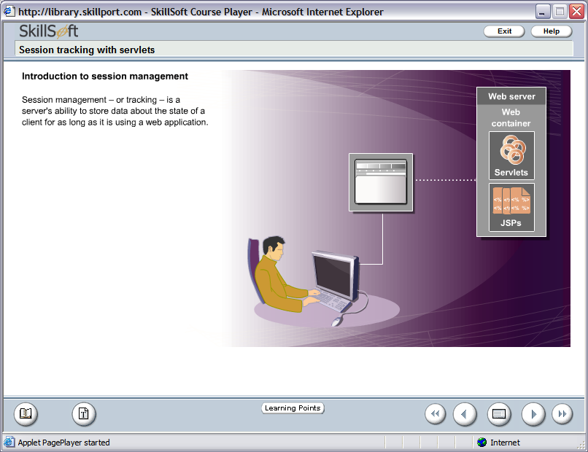
Session Management in Servlets
Session Management – or tracking – is a server’s ability to store data about the state of a client for as long as it is using a web application.
74

Slide 75
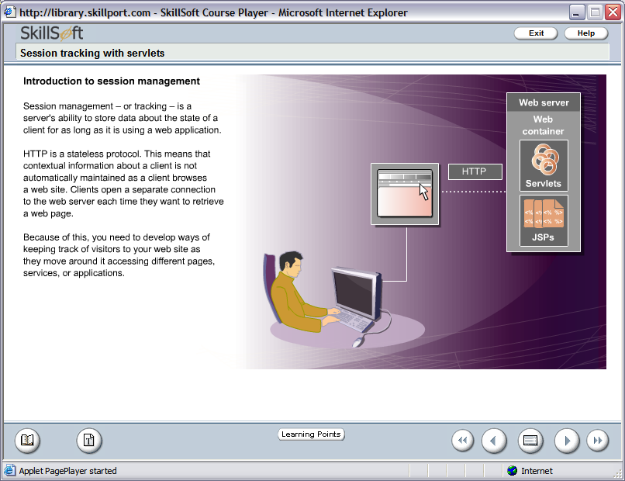
Session Management in Servlets (Contd.)
HTTP is a stateless protocol.
This means:
Contextual information about a client is not automatically maintained as a client browses a web site.
Clients open a separate connection to the web server each time they want to retrieve a web page.
75

Slide 76
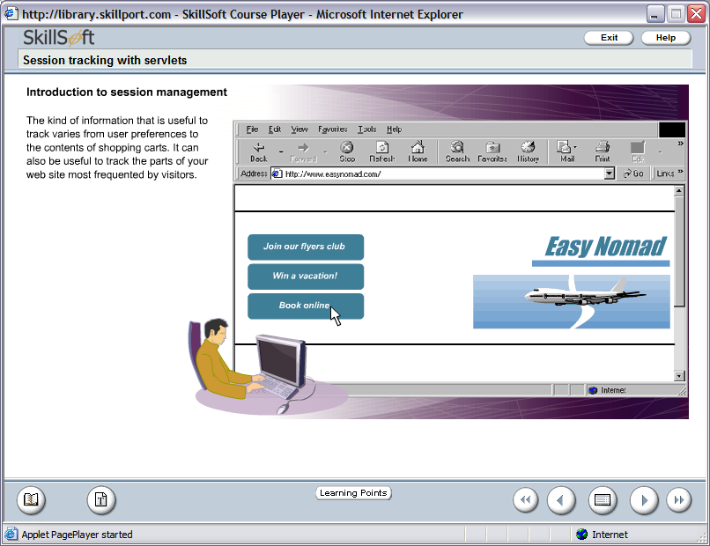
Session Management in Servlets (Contd.)
The kind of information that is useful to track varies from user to the contents of shopping carts. It can also be useful to track the parts of your web site most frequented by visitors.
76

Slide 77
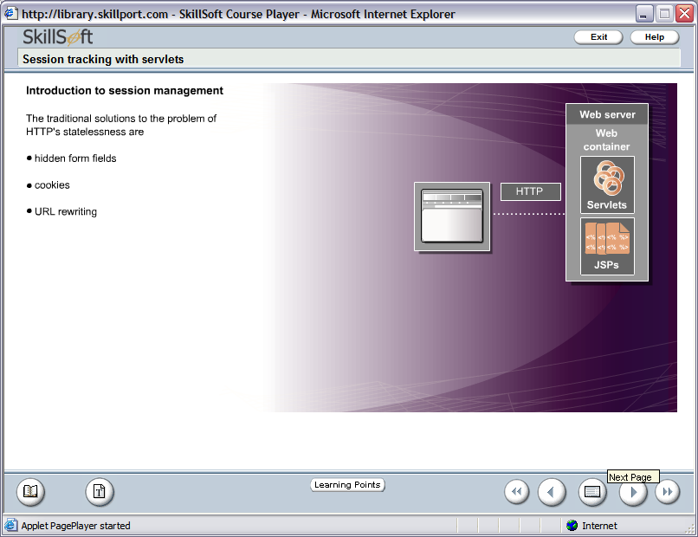
Session Management in Servlets (Contd.)
The solutions of the problem of HTTP’s statelessness are
1.
Hidden Form Fields
2.
Cookies
3.
URL Rewriting
4.
HttpSession
77

Slide 78
Session Management in Servlets (Contd.)
The solutions of the problem of HTTP’s statelessness are
a) Hidden form fields are fields on HTML forms
that are hidden from the user.
b) This information is included in POST or GET
data.
How to create a Hidden Form Field
<input type=“hidden”
name=“HUser”
value=“SomeValue”>
1.
Hidden Form Fields
2.
Cookies
3.
URL Rewriting
4.
HttpSession
78
Notes:
78
A hidden form field method will not work if the user comes across a static document.

Slide 79
Demonstration on Hidden Form Fields – Login.htm
Track User Demo Through Hidden Form Fields
<HTML>
<TITLE>ONLINE SHOPPING</TITLE>
<BODY>
<FORM ACTION=“http://localhost:9080/HiddenWorldProject/FirstWorld”>
UserName <INPUT Type=“Text” Name=“user”><br>
<INPUT Type=Submit value=“Login”>
</FORM>
</BODY>
</HTML>
79
Notes:
79

Slide 80
Demonstration on Hidden Form Fields – FirstWorld.java
package .sample.session;
import java.io.*;
import javax.servlet.*;
import javax.servlet.http.*;
public class FirstWorld extends HttpServlet
{
public void doGet(HttpServletRequest req, HttpServletResponse res)throws IOException, ServletException
{
String username = req.getParameter(“user”);
PrintWriter out = res.getWriter();
out.println(“”Welcome! Click To Proceed….”);
out.println(“<form name=login
action=http://localhost:9080/HiddenWorldProject/SecondWorld>
out.println(“<input type=hidden name=user value=“+username+”>”);
out.println(“<input type=submit value=submit></form>”);
}// end of doPost() method
}// end of FirstWorld class
80
Notes:
80

Slide 81
Demonstration on Hidden Form Fields – SecondWorld.java
package .sample.session;
import java.io.*;
import javax.servlet.*;
import javax.servlet.http.*;
public class SecondWorld extends HttpServlet
{
public void doGet(HttpServletRequest req, HttpServletResponse res)throws IOException, ServletException
{
String username = req.getParameter(“user”);
PrintWriter out = res.getWriter();
out.println(“Hello! “+username);
}// end of doPost() method
}// end of SecondWorld class
81
Notes:
81

Slide 82
Session Management in Servlets (Contd.)
Cookies are small bits of data, size of each cookie is maximum of 4 KB, that are stored on the client machine by the web server.
Cookies include a session ID to represent the specific client. It has a key-value pair.
The cookie information stored on the client machine is returned to the server in subsequent sessions to allow the server to retrieve this information without having to prompt the client for it again.
It is not suitable for maintaining sensitive information, and clients can refuse to accept cookies.
The solutions of the problem of HTTP’s statelessness are
1.
Hidden Form Fields
2.
Cookies
3.
URL Rewriting
4.
HttpSession
82

Slide 83
Cookies Methods
a) public String getName()
Returns the name of the cookie.
b) public void setMaxAge(int expiry)
Sets the maximum time for which the client browser retains the cookie value.
c) public int getMaxAge()
Returns the maximum age of the cookie in seconds.
d) public void setValue(String val)
Sets a new value to the cookie.
e) public String getValue()
Returns the value of the String.
The solutions of the problem of HTTP’s statelessness are
1.
Hidden Form Fields
2.
Cookies
3.
URL Rewriting
4.
HttpSession
83

Slide 84

Demonstration on Adding a Cookie
Write a servlet that will add a cookie named userinfo in the client
machine.
84

Slide 85
Session Management in Servlets (Contd.)
The solutions of the problem of HTTP’s statelessness are
URL Rewriting is a solution in which extra data, including a session ID is appended to the end of each URL. So as the client browses through a site, the session id is passed from page to page.
This solution works when the browser does not support cookies or user has disabled them.
In URL Rewriting the server process has to ensure that the session ID is appended in the URL, if not redirection lead to session information being lost.
1.
Hidden Form Fields
2.
Cookies
3.
URL Rewriting
4.
HttpSession
85
Notes:
85
To counteract URL Rewriting associated problem of losing information during redirection, the HttpServletResponse encodeURL() method can be used to rewrite internal links so that they include the session ID.

Slide 86
Demonstration on URL Rewriting – Login.htm
Track User Demo Through URL Rewriting
<HTML>
<TITLE>ONLINE SHOPPING</TITLE>
<BODY>
<FORM ACTION=“http://localhost:9080/URLRewitingWorldProject/URLFirstWorld” METHOD=“POST”>
UserName <INPUT Type=“Text” Name=“user”><br>
<INPUT Type=Submit value=“Login”>
</FORM>
</BODY>
</HTML>
86
Notes:
86

Slide 87
Demonstration on URL Rewriting – URLFirstWorld.java
package .sample.session;
import java.io.*;
import javax.servlet.*;
import javax.servlet.http.*;
public class URLFirstWorld extends HttpServlet
{
public void doPost(HttpServletRequest req, HttpServletResponse res)throws IOException, ServletException
{
String username = req.getParameter(“user”);
res.setContentType(“text/html”);
PrintWriter out = res.getWriter();
out.println(“Hello! <a href=http://localhost:9080/URLRewitingWorldProject/URLSecondWorld?uname=“+username+”> Click Here </a> to proceed”);
}// end of doPost() method
}// end of URLFirstWorld class
87
Notes:
87

Slide 88
Demonstration on URL Rewriting – URLFirstWorld.java
http://localhost:8080/URLRewritingWorldProject/URLFirstWorld
88
Notes:
88

Slide 89
Demonstration on URL Rewriting – URLSecondWorld.java
package .sample.session;
import java.io.*;
import javax.servlet.*;
import javax.servlet.http.*;
public class URLSecondWorld extends HttpServlet
{
public void doPost(HttpServletRequest req, HttpServletResponse res)throws IOException, ServletException
{
String username = req.getParameter(“uname”);
res.setContentType(“text/html”);
PrintWriter out = res.getWriter();
out.println(“Hello! ”+username);
}// end of doPost() method
}// end of URLSecondWorld class
89
Notes:
89

Slide 90
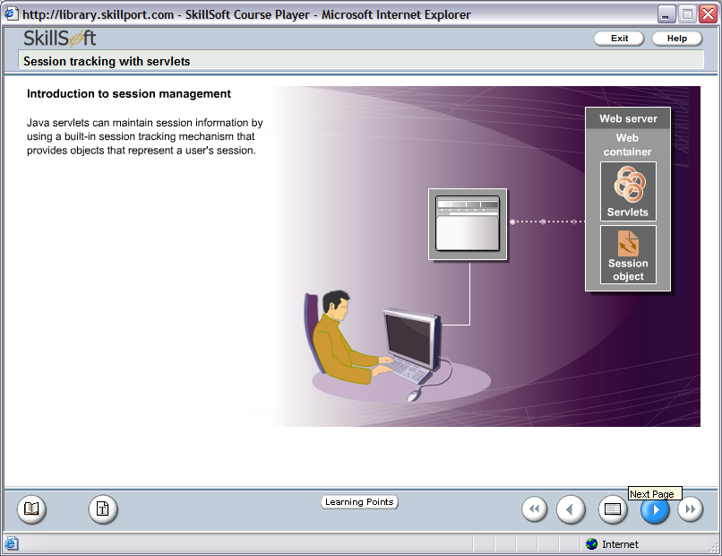
Session Management in Servlets: Using HttpSession
Java Servlets can maintain session information by using a built-in session tracking mechanism that provides objects that represent a user’s session.
90

Slide 91
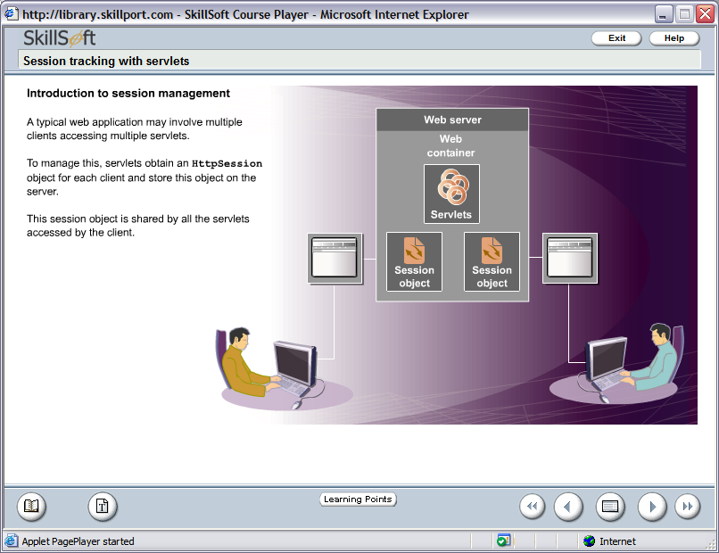
Session Management in Servlets: Using HttpSession (Contd.)
How To Manage multiple client Access to the Servlet?
Obtain an HttpSession object for each client and store this object on the server
91

Slide 92
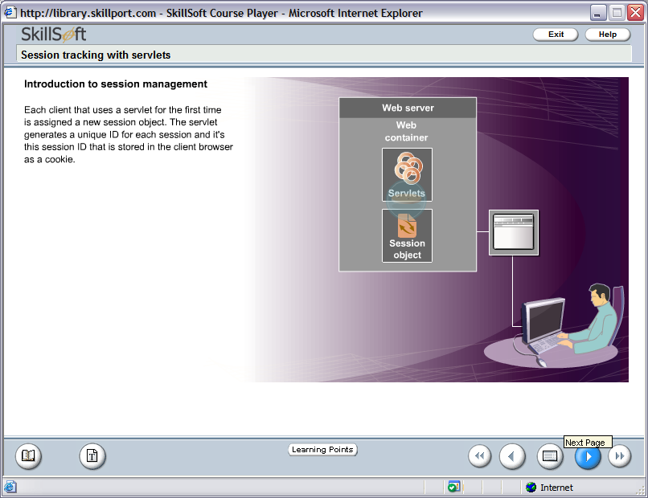
Session Management in Servlets: Using HttpSession (Contd.)
Each client that uses a servlet for the first time is assigned a new session object. The servlet generates a unique ID for each session and its this session ID that is stored in the client browser as a cookie
When a client makes a subsequent request to the server, the servlet receives that client’s session ID cookie. It uses this cookie as a key to find the session object associated with that request.
92

Slide 93
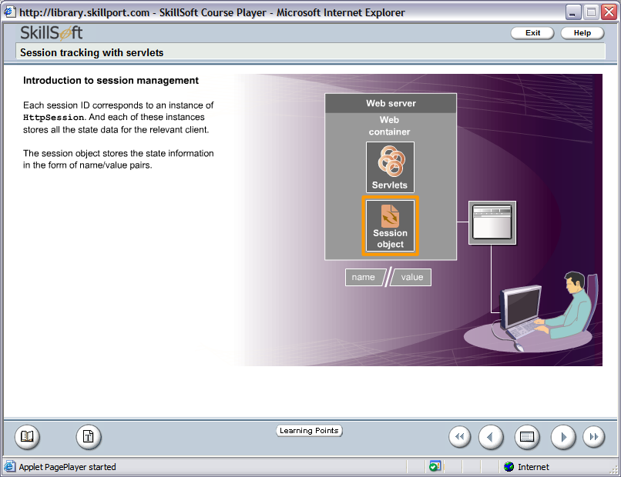
Session Management in Servlets: Using HttpSession (Contd.)
Each session id corresponds to an instance of HttpSession. And each of these instances stores all the data for the relevant client.
The session object stores the state information in the form of name/value pairs.
93

Slide 94
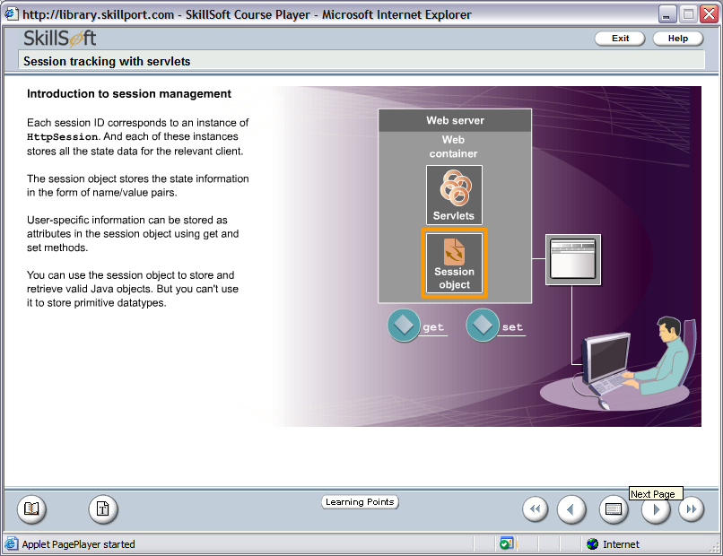
Session Management in Servlets: Using HttpSession (Contd.)
User-specific information can be stored as attributes in the session object using
94
Notes:
94
You can use the session object to store and retrieve valid Java objects. But you can’t use it to store primitive datatypes.

Slide 95
Demonstration on HttpSession: UserSession.java
package .sample.session;
import java.io.*;
import javax.servlet.*;
import javax.servlet.http.*;
public class UserSession extends HttpServlet {
public void doGet(HttpServletRequest request, HttpServletResponse response)
throws IOException, ServletException
{
response.setContentType("text/html");
PrintWriter out = response.getWriter();
out.println("<html>");
out.println("<head>");
out.println("<title>Session Demonstration!</title>");
out.println("</head>");
out.println("<body><pre>");
95

Slide 96
Demonstration on HttpSession: UserSession.java
out.println("<h1>Welcome !</h1>");
HttpSession sess = request.getSession(true);
out.println("<table border=1><tr><td>Session ID : </td><td>"+sess.getId()+"</td></tr>");
out.println("<tr><td>Session Creation Time : </td><td>"+sess.getCreationTime()+"</td></tr>");
out.println("<tr><td>Session Last Accessed Time : </td><td>"+sess.getLastAccessedTime()+"</td></tr>");
String s=request.getParameter("uname");
sess.setAttribute("username",s);
out.println("<tr><td>Session User Name is : </td><td>" +sess.getAttribute("username")+"</td></tr></table>");
96

Slide 97
Demonstration on HttpSession: UserSession.java
out.println("<br><br><form>Enter Your Name Please : <input type=text name=uname></p><br><input type=submit name=Submit value=Submit></form>");
out.println("</body>");
out.println("</html>");
}
}
97

Slide 98
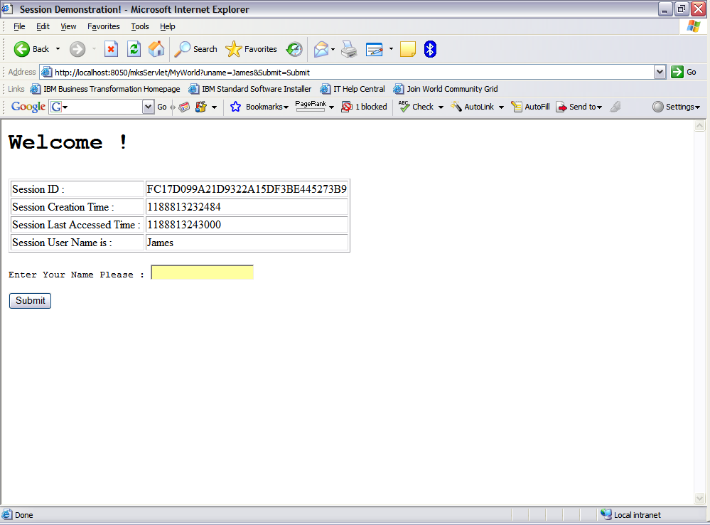
Demonstration on HttpSession: UserSession.java
98

Slide 99
Session Management in Servlets: Using HttpSession (Contd.)
How To Make Session InActive or Terminate
public void setMaxInactiveInterval(int interval) - When Session timeout occurs any objects bound to the HttpSession object are automatically unbound.
To retrieve Inactive interval
public int getMaxInactiveInterval()
99
Notes:
99
Session will never time out if the second parameter used is negative.
In the web.xml file also you can mention the timeout in the <session-timeout><session-timeout> element.

Slide 100
Session Management in Servlets: Using HttpSession (Contd.)
To deactivate a session - use
public void invalidate() method
This method explicitly ends the session and unbinds all objects associated with it. It should be used with care to prevent destroying data being used by another servlet or JSP page.
100

Slide 101
Inter-Servlet Communication
A process where two or more servlets communicates with each other to process the client request.
A servlet can forward the request to another servlet to the process
the client request.
A servlet can include the output of another servlet to process the
client request.
101

Slide 102
Inter-Servlet Communication (Contd.)
Inter-Servlet Communication can be implemented in the following two
ways:
RequestDispatcher
Servlet Request object
102

Slide 103
Inter-Servlet Communication (Contd.)
Inter-Servlet Communication Using RequestDispatcher
RequestDispatcher is an object of javax.servlet.RequestDispatcher Interface that allows inter-servlet communication.
Object is used to include the content of another servlet.
Implemented using include() method of RequestDispatcher interface.
Object is used to forward the request to another servlet.
Implemented using forward() method of RequestDispatcher interface.
103
Notes:
103
Can make a servlet call the methods of other servlet. Possible if both servlets are a part of the same web application.
The following code snippet shows the how to call getCounterInfo() method from a servlet Counter.
ServletContext context = getServletContext();
Counter ctr = (Counter) context.getServlet(“Counter”); // “Counter” passed as parameter to getServlet() method is the alias of the Servlet.
ctr.getCounterInfo();

Slide 104
Inter-Servlet Communication (Contd.)
Inter-Servlet Communication Using Servlet Request Object
Stores the calculated data as attribute to the request object in the servlet.
Forwards the request to the second servlet using the RequestDisptacher.
Retrieves the data from the request object and displays the result using the second servlet.
104
Notes:
104

Slide 105
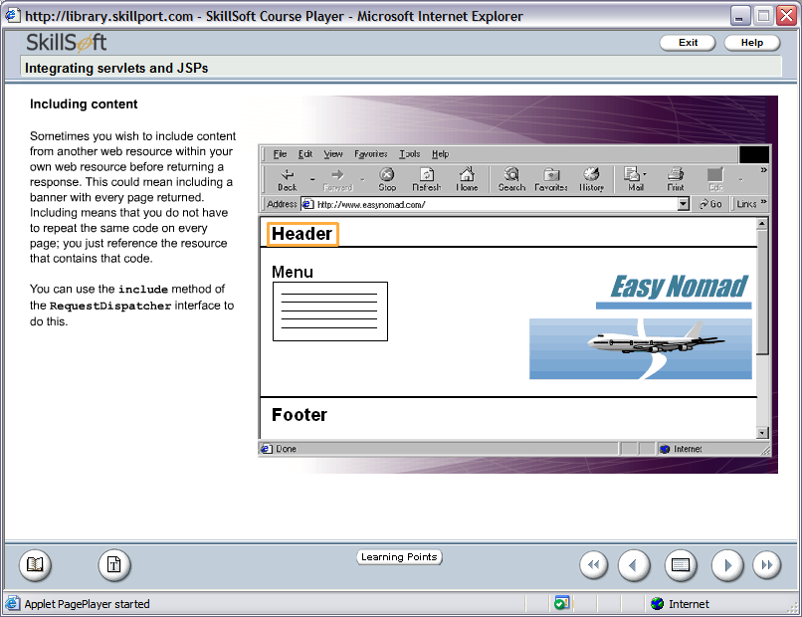
Inter-Servlet Communication: Request Dispatcher Object Methods
1.
include() method
When you wish to include content from another web resource within your own web resource before returning a response – Use include() method.
Example:
Including a banner with every page returned.
105

Slide 106
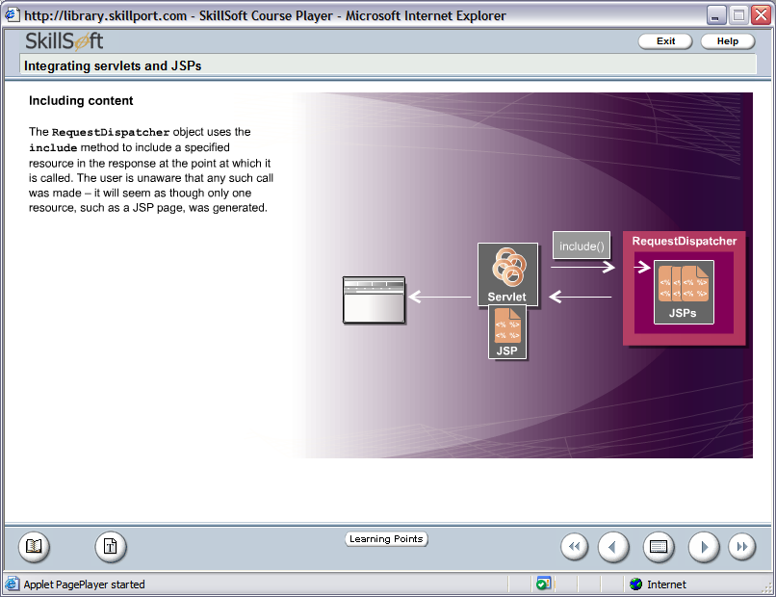
Request Dispatcher Object Methods
The RequestDispatcher object uses the include() method to include a specified resource in the response at the point at which it is called. The user is unaware that any such call was made – it will seem as though only one resource, such as JSP page, was generated.
106

Slide 107

Demonstration: Using Include
Write a servlet that will include the contact information of the web
administrator from an another Servlet in the footer section and in the
body section it will greet the user with a welcome message.
107

Slide 108
Login Page – Login.html
<HTML>
<BODY>
<FORM ACTION ="http://localhost:9080/IncludeServletProject/UserLoginServlet">
<TABLE ALIGN = "CENTER">
<TR>
<TD ALIGN = "RIGHT">User Name </TD>
<TD> <INPUT TYPE = "TEXT" NAME="uname"> </TD>
</TR>
<TR>
<TD ALIGN = "RIGHT">Password </TD>
<TD> <INPUT TYPE = "PASSWORD" NAME=“password"> </TD>
</TR>
<TR>
<TD ALIGN = "RIGHT"> </TD>
<TD ALIGN = "RIGHT"> <INPUT TYPE = "SUBMIT" NAME="SUBMIT" VALUE = "Login"> </TD>
</TR>
</TABLE>
</FORM>
</BODY>
</HTML>
108

Slide 109
Servlet-1: ContactServlet.java
package .sample.include;
import javax.servlet.*;
import javax.servlet.http.*;
import java.io.*;
public class ContactServlet extends HttpServlet
{
public void doGet(HttpServletRequest req, HttpServletResponse res) throws ServletException, IOException
{
PrintWriter out=res.getWriter();
res.setContentType("text/html");
out.println(“<address>Web Admin Name : GoodJava<br>");
out.println("Email Address : goodname@goodjava.com</address><br>");
}
}
109

Slide 110
Servlet-2: UserLoginServlet.java
package .sample.include;
import javax.servlet.*;
import javax.servlet.http.*;
import java.io.*;
public class UserLoginServlet extends HttpServlet
{
public void doGet(HttpServletRequest req, HttpServletResponse res) throws ServletException, IOException
{
PrintWriter out=res.getWriter();
/* Set content type to text/html */
res.setContentType("text/html");
String user_name=req.getParameter("uname");
out.println(“<pre><h3> Hello &nbsp;" + uname +"! &nbsp;Welcome to the Inter-Servlet Communication</h3>");
out.println("<b>Contact information of Application Administrator is</b><br>");
/* Forward request to ContactServlet servlet */
RequestDispatcher disp = req.getRequestDispatcher(“ContactServlet”);
disp.include(req, res);
}
}
110

Slide 111
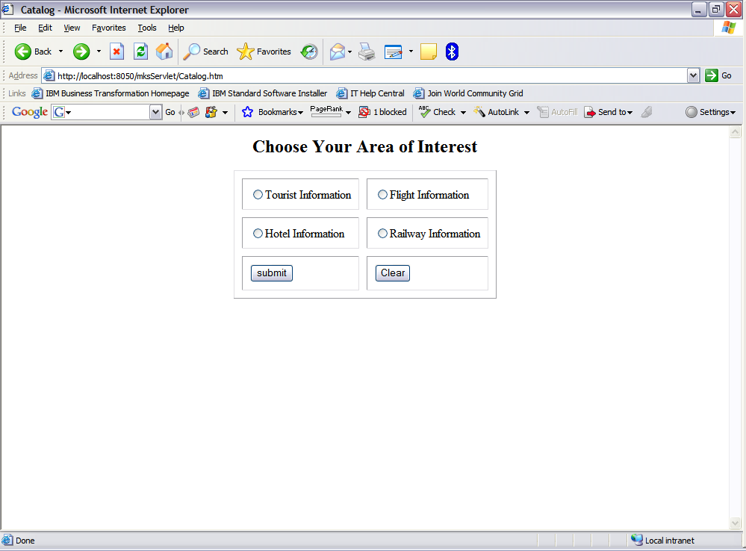
Request Dispatcher Object Methods
2.
forward() method
When you wish to forward the request and response to another servlet for further processing or final output
– Use forward() method.
Example:
Processing a catalog request and forwarding the request to designated servlet page.
111

Slide 112
Demonstration: Using forward
Write a servlet that will dispatch the request to designated servlet based
on the choice made in the Catalog page.
112

Slide 113
Catalog Page – Catalog.html
<html>
<title>Catalog</title>
<body>
<center>
<form action="http://localhost:9080/ForwardServletProject/ChoiceServlet">
<h2>Choose Your Area of Interest</h2>
<table cellspacing =10 cellpadding=10 border=1>
<tr><td><input type="radio" name="r1" value="Tourist">Tourist Information</td>
<td><input type="radio" name="r1" value="Flight">Flight Information</td></tr>
<tr>
<td><input type="radio" name="r1" value="Hotel">Hotel Information</td>
<td><input type="radio" name="r1" value="Railway">Railway Information</td>
</td>
</tr>
<tr><td><input type="submit" value="submit"></td><td><input type="reset" value="Clear"></td></tr>
</table>
</form>
</center>
</body>
</html>
113

Slide 114
Choice Servlet– ChoiceServlet.java
package .sample.forward;
import java.io.*;
import javax.servlet.*;
import javax.servlet.http.*;
public class ChoiceServlet extends HttpServlet {
public void doGet(HttpServletRequest request, HttpServletResponse response)
throws IOException, ServletException
{
String type = request.getParameter("r1");
if(type.equals("Tourist"))
{
RequestDispatcher rd = getServletContext().getRequestDispatcher("/Tourist");
rd.forward(request,response);
}
114

Slide 115
Choice Servlet– ChoiceServlet.java
if(type.equals("Flight"))
{
RequestDispatcher rd = getServletContext().getRequestDispatcher("/Flight");
rd.forward(request,response);
}
if(type.equals("Hotel"))
{
RequestDispatcher rd = getServletContext().getRequestDispatcher("/Hotel");
rd.forward(request,response);
}
if(type.equals("Railway"))
{
RequestDispatcher rd = getServletContext().getRequestDispatcher("/Railway");
rd.forward(request,response);
}
}
}
115

Slide 116
Tourist Servlet – Tourist.java
package .sample.forward;
import java.io.*;
import javax.servlet.*;
import javax.servlet.http.*;
public class Tourist extends HttpServlet {
public void doGet(HttpServletRequest request, HttpServletResponse response)
throws IOException, ServletException
{
response.setContentType("text/html");
PrintWriter out = response.getWriter();
out.println("<h2>Tourist Place Details Will Be Available Shortly...</h2>");
out.println("<hr color='blue' size=5>");
}
}
116

Slide 117
Flight Servlet – Flight.java
package .sample.forward;
import java.io.*;
import javax.servlet.*;
import javax.servlet.http.*;
public class Flight extends HttpServlet {
public void doGet(HttpServletRequest request, HttpServletResponse response)
throws IOException, ServletException
{
response.setContentType("text/html");
PrintWriter out = response.getWriter();
out.println("<h2>Flight Information Will Be Available Shortly...</h2>");
out.println("<hr color='blue' size=5>");
}
}
117

Slide 118
Hotel Servlet – Hotel.java
package .sample.forward;
import java.io.*;
import javax.servlet.*;
import javax.servlet.http.*;
public class Hotel extends HttpServlet {
public void doGet(HttpServletRequest request, HttpServletResponse response)
throws IOException, ServletException
{
response.setContentType("text/html");
PrintWriter out = response.getWriter();
out.println("<h2>Hotel Information Will Be Available Shortly...</h2>");
out.println("<hr color='blue' size=5>");
}
}
118

Slide 119
Railway Servlet – Railway.java
package .sample.forward;
import java.io.*;
import javax.servlet.*;
import javax.servlet.http.*;
public class Railway extends HttpServlet {
public void doGet(HttpServletRequest request, HttpServletResponse response)
throws IOException, ServletException
{
response.setContentType("text/html");
PrintWriter out = response.getWriter();
out.println("<h2>Railway Time-Table Information Shortly Available...</h2>");
out.println("<hr color='blue' size=5>");
}
}
119

Slide 120

Inter-Servlet Communication: Do’s & Don’ts of RequestDispatcher
Do’s of RequestDispatcher
allows inter-servlet communication by forwarding request to another servlet and including response from another servlet.
Don'ts of RequestDispatcher
it does not allow servlets to share data.
120

Slide 121
Inter-Servlet Communication: ServletRequest Object
To share data among the servlets use –
ServletRequest object methods
setAttribute()
To set the values of the data in the request object.
getAttribute()
To retrieve the value of the data.
121

Slide 122
Demonstration: Using Servlet Request Object
Create a web application that performs arithmetic calculation on two
numbers provided by the user. Another servlet of the web application
displays the calculation result.
122

Slide 123
User Interface To Enter Two Numbers: TwoNo.html
<html>
<title>Input Form</title>
<body>
<center>
<form action="http://localhost:9080/RequestObjectProject/ArithmeticServlet">
<h2><u>Input Screen</u></h2>
<table cellspacing =10 cellpadding=10 border=1>
<tr><td>Enter 1st Number : </td><td><input type=“text” name=“no1”></td></tr>
<tr><td>Enter 2nd Number : </td><td><input type=“text” name=“no2”></td></tr>
<tr><td><input type="submit" value=“Add"></td><td><input type="reset" value="Clear"></td></tr>
</table>
</form>
</center>
</body>
</html>
123

Slide 124
Servlet To Calculate Sum: ArithmeticServlet.java
package .sample.sum;
import java.io.*;
import javax.servlet.*;
import javax.servlet.http.*;
public class ArithmeticServlet extends HttpServlet {
public void doGet(HttpServletRequest request, HttpServletResponse response)
throws IOException, ServletException
{
int number1 = Integer.parseInt(request.getParameter(“no1”));
int number2 = Integer.parseInt(request.getParameter(“no2”));
int sum = number1 + number2;
request.setAttribute(“sumresult”,new Integer(sum));
ServletContext context = getServletConfig().getServletContext();
RequestDispatcher rd = context.getRequestDispatcher(“/DisplaySumServlet”);
rd.forward(request,response);
}
}
124

Slide 125
Servlet To Display Sum: DisplaySumServlet.java
package .sample.sum;
import java.io.*;
import javax.servlet.*;
import javax.servlet.http.*;
public class DisplaySumServlet extends HttpServlet {
public void doGet(HttpServletRequest request, HttpServletResponse response)
throws IOException, ServletException
{
Integer res = (Integer) request.getAttribute(“sumresult”);
response.setContentType(“text/html”);
PrintWriter out = response.getWriter();
out.println(“<h1>Result </h1><br><hr color=‘blue’ size=5>”);
out.println(“<h2>The summation of two number is = <font color=‘blue’>“+res.toString()+ “</font></h2>”);
}
}
125

Slide 126
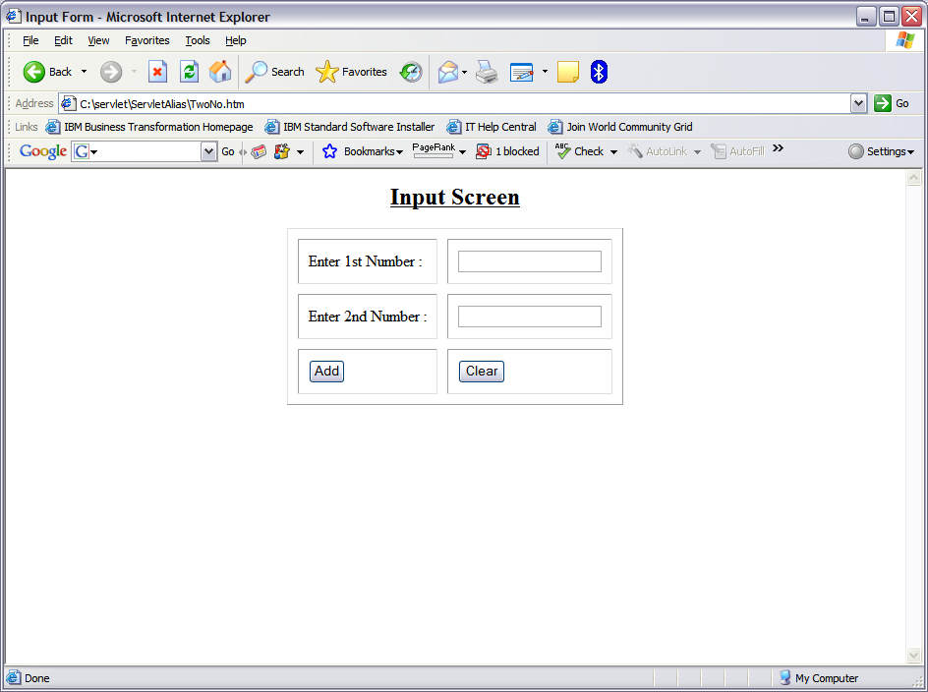
Output of TwoNo.html
http://localhost:8080/RequestObjectProject/TwoNo.html
126

Slide 127
sendRedirect() Vs forward()
sendRedirect() | forward()
sendRedirect() is a method of HttpServletResponse interface. | forward() is a method of RequestDispatcher interface.
It sends a redirect response back to the client’s browser. The browser will normally interpret this response by initiating a new request to the redirect URL given in the response. | forward does not involve the client’s browser. It just takes browser’s current request, and hands it off to another servlet/jsp than they originally called.
Because a new request is being submitted all previous stored in the request will be unavailable. | forward is performed internally by the servlet.
127
Notes:
127

Slide 128
sendRedirect() Vs forward()
sendRedirect() | forward()
This method is useful for redirecting to pages on other servers and domains. | This method is useful when communicating between server resources (servlet to servlet).
A browser reload of the second URL will not repeat the original request, but will rather fetch the second URL. The back and forward button will work. | Browser is completely unaware that it has taken place, so its original URL remains intact. So, back and forward button of web browser will not work.
Redirect is always slower than a forward, since it requires a second browser request. | No network round trip is required to the server, so it is faster.
128
Notes:
128
There are different situations where you want to use one or the other. For example, if you want to hide the fact that you're handling the browser request with multiple servlets/jsp, and all of the servlets/jsp are in the same web application, use forward() or include(). If you want the browser to initiate a new request to a different servlet/jsp, or if the servlet/jsp you want to forward to is not in the same web application, use sendRedirect().

Slide 129

Exercise on Session Management
HappyVisit online shopping wants to keep track of the
Trouser’s selection made by the shopper and accordingly
calculate the Invoice price at the last.
A diagram is shown in the next slide to demonstrate the
working of the total module.
129

Slide 130
Exercise on Session Management
LoginScreen
Accept UserName and Password and on submission call DisplayTrouserListServlet.
DisplayTrouserListServlet
This servlet displays the list of trouser available in the stock and on submission call a Servlet known as ChoiceProcessingServlet for further processing.
ChoiceProcessingServlet
This servlet keep track of the user selection of the trouser and forward the selected trouser list to the FinalServlet for Billing the user.
FinalServlet
This servlet calculate the total bill for the user based on the Trouser selected (Trouser selection information retrieved from ChoiceProcessingServlet)
130

Slide 131
HappyVisit Login Page – Login.html
<HTML>
<TITLE>HappyVisit Online Shopping Portal</TITLE>
<BODY>
<FORM ACTION = "http://localhost:9080/SessionServletProject/DisplayTrouserListServlet" align=“CENTER”>
Username: <INPUT TYPE = TEXT NAME = "user" align=CENTER><BR>
Password: <INPUT TYPE = PASSWORD NAME = "password" align=CENTER><BR>
<INPUT TYPE = SUBMIT VALUE = "Login" align=CENTER>
</FORM>
</BODY>
</HTML>
131

Slide 132
HappyVisit Servlet -1: DisplayTrouserListServlet.java
package .sample.login;
import java.io.*;
import javax.servlet.*;
import javax.servlet.http.*;
public class DisplayTrouserListServlet extends HttpServlet
{
public void doGet(HttpServletRequest req, HttpServletResponse res) throws ServletException, IOException
{
String username = req.getParameter("user");
String password = req.getParameter("password");
int counter = 0;
PrintWriter out = res.getWriter();
out.println( username + "! Welcome to HappyVisit Online Shopping.<BR>");
132

Slide 133
HappyVisit Servlet -1: DisplayTrouserListServlet.java
counter = 0;
/* Create a session for the user and store the value of username. */
HttpSession session = req.getSession(true);
session.setAttribute("user", username);
}
else
{
out.println("Sorry! Invalid username and password");
counter = 1;
}
if (counter == 0)
{
/* Display the contents to the user. */
out.println("<HTML><BODY>");
out.println("<HR>");
out.println("<FORM ACTION = http://localhost:9080/SessionServletProject/ChoiceProcessingServlet METHOD=POST>");
133

Slide 134
HappyVisit Servlet -1: DisplayTrouserListServlet.java
out.println("<TABLE WIDTH=500>");
out.println("<TR><TH>ITEM NO</TH> <TH>Brands of Trousers </TH> <TH>BUY</TH> </TR> ");
out.println("<TR><TD> 1 </TD><TD> PeterEngland </TD> <TD> <INPUT NAME = c1 TYPE = CHECKBOX VALUE = PeterEngland ></TD> </TR> ");
out.println("<TR><TD> 2 </TD><TD> Moustache </TD> <TD> <INPUT NAME = c2 TYPE = CHECKBOX VALUE = Moustache ></TD> </TR> ");
out.println("<TR><TD> 3 </TD><TD> Allen Solly </TD> <TD> <INPUT NAME = c3 TYPE = CHECKBOX VALUE = Allen Solly></TD> </TR> ");
out.println("<TR><TD> 4 </TD><TD> Zodiac </TD> <TD> <INPUT NAME = c4 TYPE = CHECKBOX VALUE = Zodiac></TD> </TR> ");
out.println("</TABLE>");
out.println("<INPUT TYPE = SUBMIT VALUE = SUBMIT>");
out.println("</FORM>");
out.println("</BODY></HTML>"); out.close();
}
}
}
134

Slide 135
HappyVisit Servlet - 2: ChoiceProcessingServlet.java
import java.io.*;
import javax.servlet.*;
import javax.servlet.http.*;
import java.util.*;
public class ChoiceProcessingServlet extends HttpServlet
{
public void doPost(HttpServletRequest request, HttpServletResponse response) throws ServletException, IOException
{
String user = null ;
String item = null;
int i = 1;
Enumeration enum = null;
PrintWriter out = response.getWriter();
HttpSession session = request.getSession(true);
135

Slide 136
HappyVisit Servlet - 2: ChoiceProcessingServlet.java
user = (String)session.getAttribute("user");
/* Retrieve the name of all the parameters passed by the end user. */
enum = request.getParameterNames();
while (enum.hasMoreElements())
{
String sname = (String)enum.nextElement();
/* Store the names in the session object. */
session.setAttribute ("c"+i, sname);
i++;
}
/* Store the counter value in the session object. */
session.setAttribute("counter", i +"");
RequestDispatcher disp = request.getRequestDispatcher("FinalServlet");
disp.forward(request, response);
}
}
136

Slide 137
HappyVisit Servlet - 3: FinalServlet.java
import java.io.*;
import javax.servlet.*;
import javax.servlet.http.*;
public class FinalServlet extends HttpServlet
{
public void doPost(HttpServletRequest request, HttpServletResponse response) throws ServletException, IOException
{
String trcode1 = null;
String trcode2 = null;
String trcode3 = null;
String trcode4 = null;
int price1 = 0;
int price2 = 0;
int price3 = 0;
int price4 = 0;
int totalPrice = 0;
String username = "";
137

Slide 138
HappyVisit Servlet - 3: FinalServlet.java
PrintWriter out = response.getWriter();
HttpSession session = request.getSession(true);
/* Retrieve the value bound to "user". */
username = (String)session.getAttribute("user");
/* Retrieve the value bound to "counter".*/
String counter = (String)session.getAttribute("counter");
int count = Integer.parseInt(counter);
for(int i=1; i<=count-1; i++)
{
/* Create a String array. */
String trname []= new String[count-1];
trname[i-1] = (String)session.getAttribute("c"+i);
138

Slide 139
HappyVisit Servlet - 3: FinalServlet.java
/* Calculate the total price of selected items.*/
if ((trname[i-1]).equals("c1"))
{
price1 = 445;
}
if ((trname[i-1]).equals("c2"))
{
price2 = 650;
}
if ((trname[i-1]).equals("c3"))
{
price3 = 565;
}
if ((trname[i-1]).equals("c4"))
{
price4 = 1275;
}}
139

Slide 140
HappyVisit Servlet - 3: FinalServlet.java
/* Calculate the total bill. */
totalPrice = price1 + price2 + price3 + price4;
/* Display the total bill that the user has to pay. */
out.println(username + “, your bill is Rs " + totalRate);
out.println("</BODY></HTML>");
out.close();
}
}
140

Slide 141
Listener
•Listeners can be registered to be notified when events occur in the Servlet container
•ServletContext (application)
–Creation, destruction, attributes setting
•Servlet
–Creation or destruction
•Session
–Creation, destruction, attribute setting, passivation

Slide 142
Listener
Implement the interface appropriate for the event you wish to be notified about
–For example ServletContextListener listens for evens on the ServletContext
•Register the listener in web.xml
–<listener> element supports a <listener-class> which will register the listener

Slide 143
Listener
ServletContextListener
Web application initialized / shut down
􀂃 ServletRequestListener
request handler starting / finishing
􀂃 HttpSessionListener
session created / invalidated
􀂃 ServletContextAttributeListener
context attribute added / removed / replaced
􀂃 HttpSessionAttributeListener
session attribute added / removed / replaced

Slide 144
Listener (example)
import javax.servlet.*;
import javax.servlet.http.*;
public class SessionMonitor
implements HttpSessionListener, ServletContextListener {
private int active = 0, max = 0;
public void contextInitialized(ServletContextEvent sce) {
store(sce.getServletContext());
}
public void contextDestroyed(ServletContextEvent sce) {}
public void sessionCreated(HttpSessionEvent se) {
active++;
if (active>max)
max = active;
store(se.getSession().getServletContext());
}

Slide 145
Listener (example)
public void sessionDestroyed(HttpSessionEvent se) {
active--;
store(se.getSession().getServletContext());
}
private void store(ServletContext c) {
c.setAttribute("sessions_active", new Integer(active));
c.setAttribute("sessions_max", new Integer(max));
}
}

Slide 146
Listener
Registration in web.xml:
<listener>
<listener-class>SessionMonitor</listener-class>
<listener>

Slide 147
What are Java Servlet Filters
147
New component framework for intercepting and modifying requests and responses
Allows ranges of custom activities
Marking access, blocking access.
Caching, Logging
Compression
Authentication, access control, encryption.
Notes:
147
Java Servlet Filter is introduced in Servlet 2.3 version

Slide 148
What can a Servlet Filter Can Do?
148
Examine the request headers
Customize the request object if it wishes to modify request headers or data.
Customize the response header object if it wishes to modify response headers or data.
Invoke the next entity in the filter chain.
Throw an exception to indicate an error in processing.

Slide 149
Use Case Scenario - 1
149
You have many servlets that need to perform common function such as logging.
You want to avoid changing all these servlets
You want to build these common function in a modular and
reusable fashion.

Slide 150
Solution For Use Case Scenario - 1
Build A Single Filter
Plug At Time Of Deployment
Logging Filter
150

Slide 151
Use Case Scenario - 2
You have many existing Web resources that need to remain unchanged except a few values such as Company Name or banners.
You cannot make changes to these Web resources every time company names get changed
151

Slide 152
Solution For Use Case Scenario - 2
Build and Deploy
Banner Replacement Filter
Company Name Replacement Filter
152

Slide 153
How are Servlet Filters Chained?
Servlet Container
Filter Chain
Servlet
Filter 1
Filter 2
Filter n
service(ServletRequest,ServletResponse)
153

Slide 154
How Servlet Filter Chain Works?
154
Multiple filters can be chained
Order is dictated by the order of <filter> elements in the web.xml deployment descriptor.
The first filter of the filter chain is invoked by the container.
via doFilter(ServletRequest req, ServletResponse res,
FilterChain chain)
The filter then perform whatever filter logic and then call the next filter in the chain by calling chain.doFilter(…) method.
The last filter’s call to chain.doFilter() ends up calling service() method of the Servlet.

Slide 155
How Servlet Filter Chain Works? (Contd.)
doFilter(ServletRequest req, ServletResponse res, FilterChain chain)
gets called each time a filter is invoked.
contains most of filtering logic.
ServletRequest object is casted to HttpServletRequest if the request is HTTP request type.
may wrap request / response objects.
invoke next filter by calling chain.doFilter(…).
or block request processing
By omitting calling chain.doFilter(…)
filter has to provide output the client.
set headers on the response for next entity.
155

Slide 156
Steps For Building a Servlet Filter
Decide what custom filtering behavior you want to implement for a web resource.
Create a class that implements Filter interface
Implement filtering logic in the doFilter() method.
Call the doFilter() method of the FilterChain object.
Configure the filter with target servlets
use <filter> and <filter-mapping> elements.
156

Slide 157
Configuration in web.xml file (Deployment Descriptor)
<filter>
<filter-name> -> assigns a name of your choosing to the filter.
<filter-class> -> used by the container to identify the filter class.
</filter>
<filter-mapping>
<filter-name> -> assigns a name of your choosing to the filter.
<url-pattern> -> declares a pattern URLs (Web Resources) to
which the filter applies.
<filter-mapping>
157
Notes:
157
A series of <filter> and <filter-mapping> elements for each filter.

Slide 158
javax.servlet.Filter Interface
158
init(FilterConfig)
Called only once when the filter is first intialized
get ServletContext object from FilterConfig object and save it somewhere so that doFilter() method can access it.
read filter initialization parameters from FilterConfig object through getInitParameter() method.
destroy()
called only once when the container removes filter object.
close files or database connections.

Slide 159
Example On Servlet Filter
package .filters;
public class LogFilter implements Filter
{
public void doFilter(ServletRequest request,ServletResponse response, FilterChain chain)throws ServletException, IOException
{
response.setContentType(“text/html”);
PrintWriter out = response.getWriter();
out.println(req.getRemoteHost() + " tried to access " +
req.getRequestURL() + " on "+new Date() + ".");
chain.doFilter(request,response);
}
public void init(FilterConfig config)throws ServletException
{
}
public void destroy()
{
}
}

Slide 160
Declaring Filter in Web.xml File
<web-app>
<!-- Register the name “Log"
for LogFilter. -->
<filter>
<filter-name>Log</filter-name>
<filter-class> .filters.LogFilter</filter-class>
</filter>
…
</web-app>
Important note
Servers load filters into memory when the Web application first comes up.

Slide 161
Mapping The Filter With a Servlet in Web.xml File
<web-app>
…
<filter-mapping>
<filter-name>Log</filter-name>
<servlet-name> .servlet.SomeServlet</servlet-name>
</filter-mapping>
…
</web-app>
Important note
Multiple entries of filter-mapping can be their depending upon how many servlets or JSP are mapped to the same Filter. In case of JSP the <servlet-name> element will be replaced by <url-pattern></url-pattern>

Slide 162
J EE 5: Web Component Development

Slide 163
Day -2 Coverage
What Is a JSP Page?
MVC Architecture The Life Cycle of a JSP Page
Execution of a JSP page
Creating Static Content
Creating Dynamic Content JSP Scripting Elements
Using Objects within JSP Pages
163

Slide 164
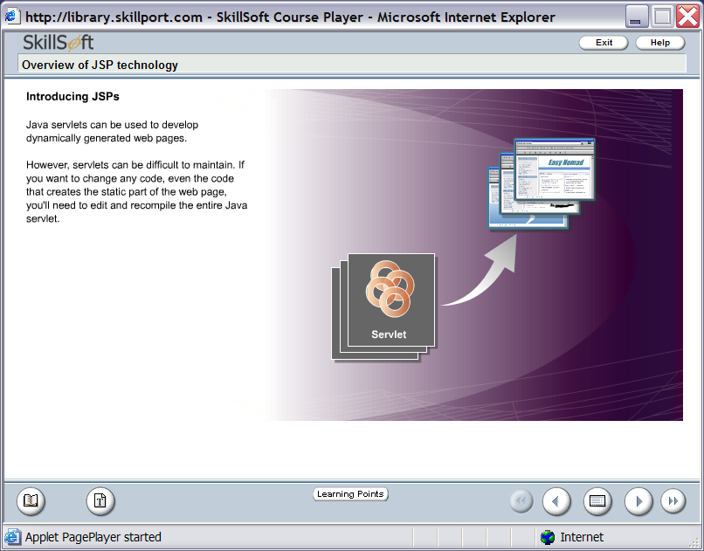
Introduction to JSP
Java servlets can be used to develop dynamically generated web pages. But it is difficult to maintain. If you want to change any code, you will need to edit and recompile the entire Java Servlet.
The Answer to this problem is?
Java Server Pages
164

Slide 165
Static & Dynamic Contents
165
Static contents
Typically static HTML page
Same display for everyone
Dynamic contents
Contents is dynamically generated based on conditions
Conditions could be
User identity
Time of the day
User entered values through forms and selections

Slide 166
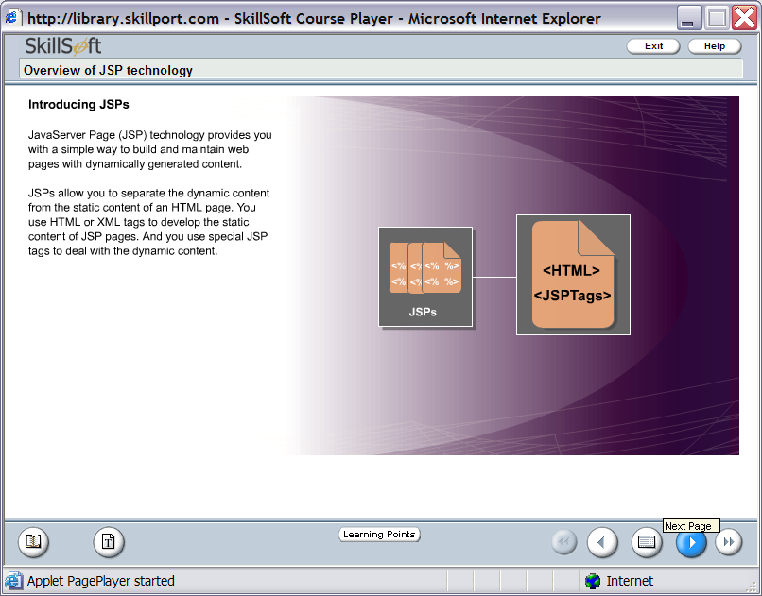
Introducing to JSP (contd.)
Java Server Page (JSP) technology provides you with a simple way to build and maintain web pages with dynamically generated content.
JSPs allow you to separate the dynamic content from the static content of an HTML page.
166

Slide 167
Benefits of JSP
Content and display logic are separated.
Simplify web application development with JSP, JavaBeans and custom tags.
Supports software reuse through the use of components (JavaBeans, Custom tags).
Automatic deployment.
Recompile automatically when changes are made to JSP pages.
Easier to author web pages.
Platform-independent.
167

Slide 168
MVC Architecture
168
What is MVC Architecture ?
Why MVC Architecture ?

Slide 169
What is MVC Architecture ?
An architecture which implements the separation of business logic and application data from the presentation data to the user is called MVC Architecture
169

Slide 170
Why MVC Architecture ?
170
Reusable : When the problems recurs, there is no need to invent a new solution, we just have to follow the pattern and adapt it as necessary.
Expressive: By using the MVC design pattern our application becomes more expressive.

Slide 171
Advantages
171
Independence of the model and views
Can have multiple views simultaneously open
Can create additional views without modifying the model.
Can create nested views without modifying the model.
Can enhance and/or optimize model without changing the views.
Easy to change “look and feel” of views.

Slide 172
Advantages
1) Multiple views using the same model: The separation of model and view allows multiple views to use the same enterprise model. Consequently, an enterprise application's model components are easier to implement, test, and maintain, since all access to the model goes through these components.
2) Easier support for new types of clients: To support a new type of client, you simply write a view and controller for it and wire them into the existing enterprise model.
3) Clarity of design: By glancing at the model's public method list, it should be easy to understand how to control the model's behavior. When designing the application, this trait makes the entire program easier to implement and maintain.
172

Slide 173
Advantages
173
4) Efficient modularity: of the design allows any of the components to be swapped in and out as the user or programmer desires - even the model! Changes to one aspect of the program aren't coupled to other aspects, eliminating many nasty debugging situations. Also, development of the various components can progress in parallel, once the interface between the components is clearly defined.
5) Ease of growth: Controllers and views can grow as the model grows; and older versions of the views and controllers can still be used as long as a common interface is maintained.
6) Distributable: With a couple of proxies one can easily distribute any MVC application by only altering the startup method of the application.

Slide 174
Servlet or JSP???
174
Servlet's strength is “controlling and dispatching”
JSP's strength is “displaying”
In a typically production environment, both servlet and JSP are used in a so-called MVC (Model-View-Controller) pattern
Servlet handles controller part
JSP handles view part

Slide 175
Life Cycle of JSP
User Request
Server
New JSP/
Modified JSP
yes
Convert to
Java Code
no
Execute Servlet
Compile
175
Notes:
175
JSP files get translated into servlet source
code, which is then compiled
● Done by the container automatically
● The first time JSP page is accessed after it
is deployed (or modified and redeployed)
● For JSP page “pageName”, the source code
resides
– <AppServer_HOME>/work/Standard
Engine/localhost/context_root/pageName$jsp.java
– <AppServer_HOME>/work/Standard
Engine/localhost/date/index$jsp.java

Slide 176
Request – Response Cycle In JSP
1. The user goes to a web site made using JSP. The user goes to a JSP page (ending with .jsp). The web browser makes the request via the Internet.
2. The JSP request gets sent to the Web server.
3. The Web server recognizes that the file required is special (.jsp), therefore passes the JSP file to the JSP Servlet Engine.
4. If the JSP file has been called the first time, the JSP file is parsed, otherwise go to step 7.

Slide 177
Request – Response Cycle In JSP
5. The next step is to generate a special Servlet from the JSP file. All the HTML required is converted to println statements.
6. The Servlet source code is compiled into a class.
7. The Servlet is instantiated, calling the init and service methods.
8. HTML from the Servlet output is sent via the Internet.
9. HTML results are displayed on the user's web browser

Slide 178
JSP Life cycle phases
178
Translation phase
Compile phase
Execution phase

Slide 179
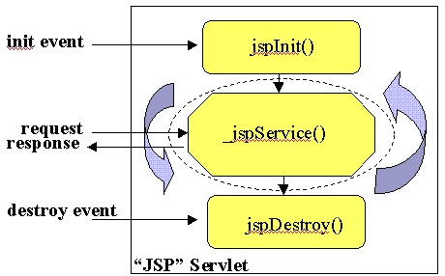
Life Cycle Methods of JSP
179

Slide 180
Initialization of a JSP Page
180
Declare methods for performing the following tasks using JSP declaration mechanism
Read persistent configuration data
Initialize resources
Perform any other one-time activities by overriding jspInit()
method of JspPage interface

Slide 181
Finalization of JSP Page
181
Declare methods for performing the following tasks using JSP declaration mechanism
Release resources
Perform any other one-time cleanup activities by overriding
jspDestroy() method of JspPage interface

Slide 182
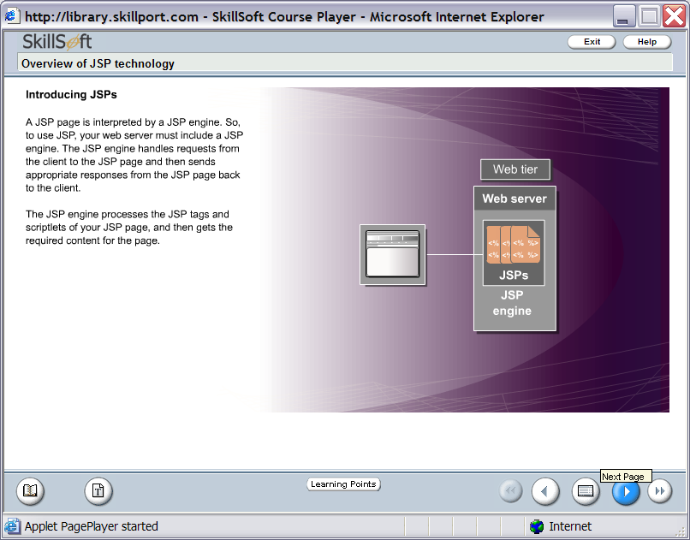
JSP Engine
A JSP page is interpreted by a JSP engine.
The JSP engine handles requests from the client to the JSP page and then sends appropriate responses from the JSP page back to the client.
The JSP engine processes the JSP tags and scriptlets of your JSP page, and then gets the required content for the page.
182

Slide 183
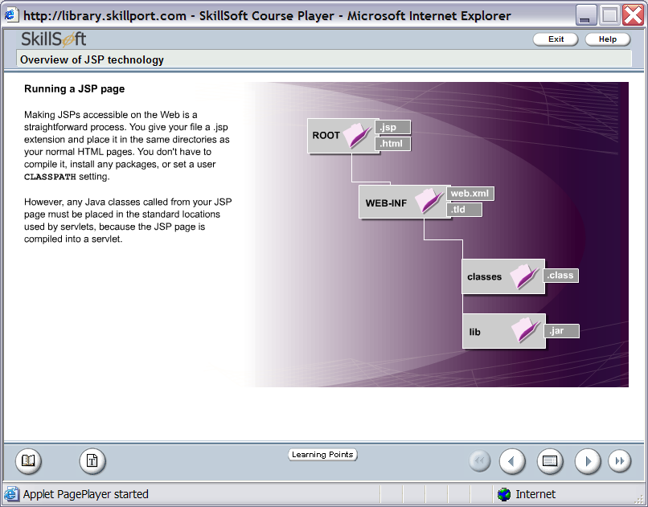
Running a JSP Page
Making JSPs accessible on the web is a straightforward process. You give your file a .jsp extension and place it in the same directories as your normal HTML pages.
183

Slide 184
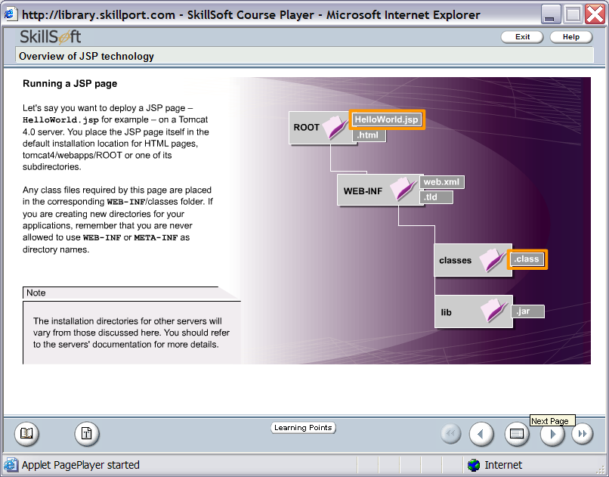
Running a JSP Page (Contd.)
Lets say you want to deploy a JSP page – HelloWorld.jsp on a Tomcat Server.
You place the JSP page itself in the default location for HTML pages.
Any class files required by this page are placed in the corresponding WEB-INF/classes folder.
server
184

Slide 185
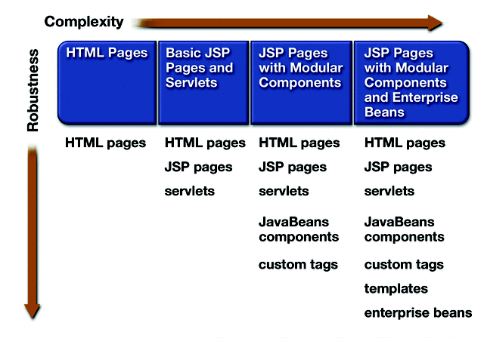
Web Application Design
185

Slide 186
Separate Request processing From Presentation
public class OrderServlet…{
public void doGet(…){
if(isOrderValid(req)){
saveOrder(req);
out.println(“<html>”);
out.println(“<body>”);
……
private void isOrderValid(….){
……
}
private void saveOrder(….){
……}
}
public class OrderServlet…{
public void doGet(…){
……if(bean.isOrderValid(..)){
bean.saveOrder(….);
forward(“conf.jsp”);
}}
Request Processing
Servlet
Presentation
<html>
<body>
<body>
</html>
JSP
Business Logic
Java Beans
isOrderValid
SaveOrder
Pure Servlet
186

Slide 187
JSP Scripting Elements
There are three JSP Constructs:
JSP
1.
Scripting Elements
2.
Directives
Directives
3.
Actions
Scripting Elements
Actions
187

Slide 188
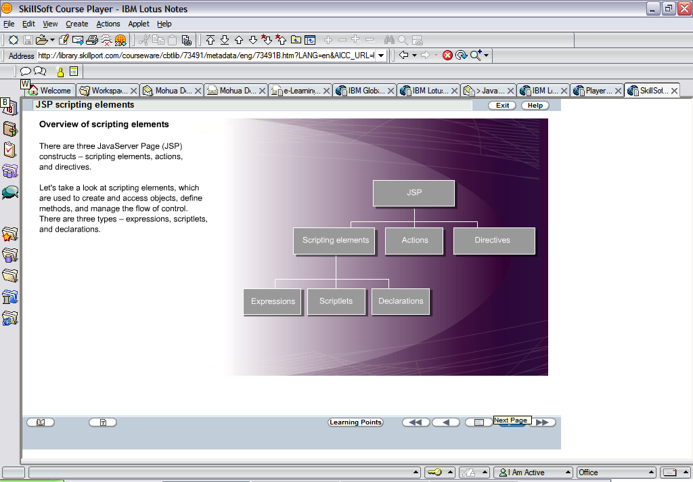
JSP Scripting Elements (Contd.)
1.
Scripting Elements
Scripting Elements are used to create Objects, define methods and manage the flow control.
There are three types of Scripting Elements:
1a.
Expressions
1b.
Scriptlets
1c.
Declarations
188

Slide 189
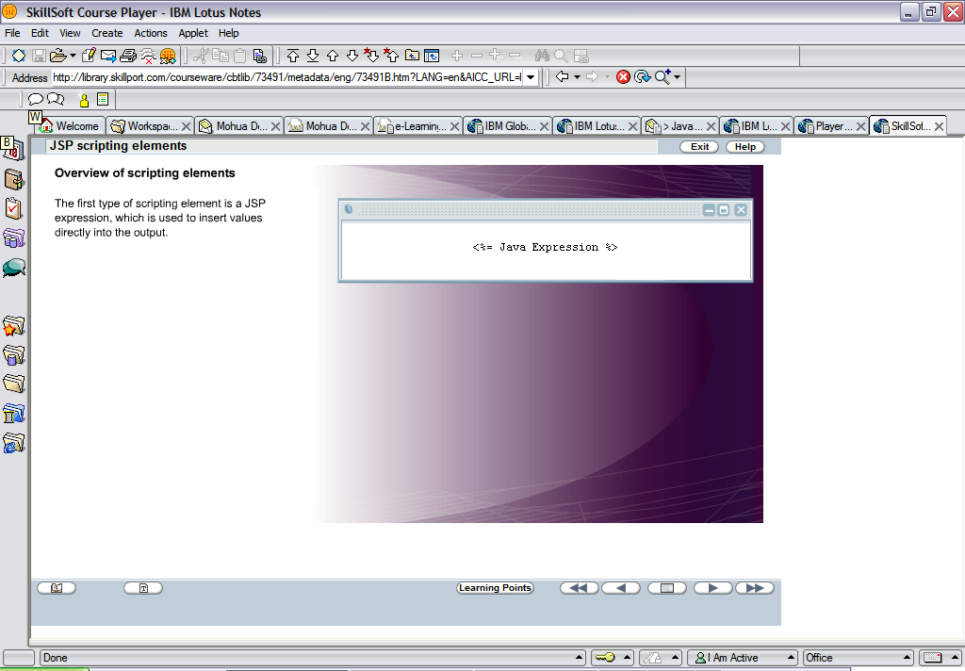
JSP Scripting Elements (Contd.) – JSP Expression
1a.
Expressions
The first type of scripting element is a JSP expression which is used to insert values directly into the output.
An expression does not end with a semi colon.
Expressions are used to add dynamic content. It acts a println statement.
189

Slide 190
JSP Scripting Elements (Contd.) – JSP Expression
Example on JSP Expression
Hello ! The time is now <%=new java.util.Date()%>
190

Slide 191
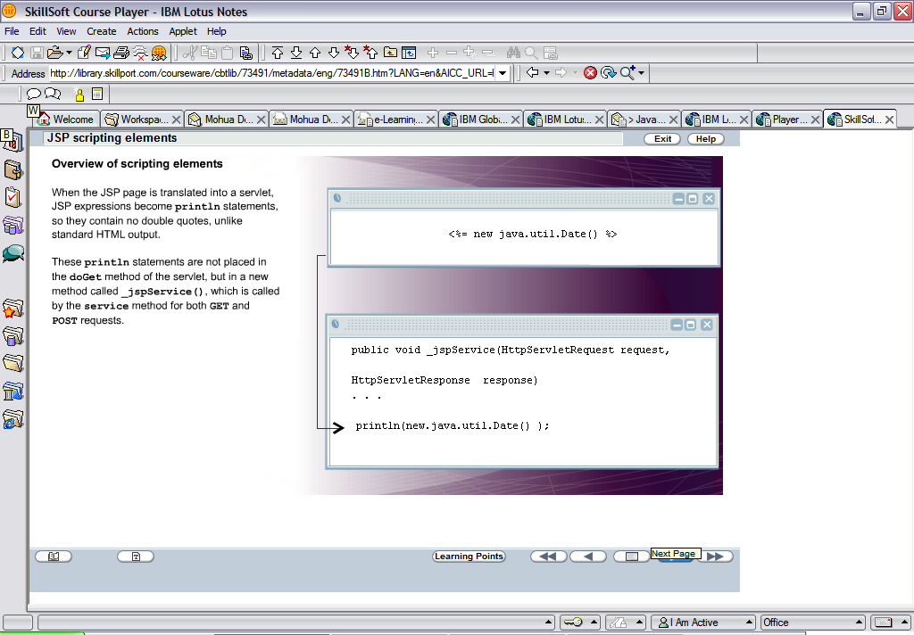
JSP Scripting Elements (Contd.) – JSP Expression
JSP expressions become
println statements and are
inserted in _jspService()
<%= new java.util.Date()%>
public void _jspService(HttpServletRequest request, HttpServletResponse response)
{
…….
println(new java.util.Date());
}
191

Slide 192
Exercise
Create a JSP page that will display only the current time in the web browser.

Slide 193
JSP Scripting Elements - Scriptlets
1b.
Scriptlets
Syntax:-
<% Some Java Codes ….
…
%>
Example:-
<%
String methodType = request.getMethod();
out.println(“The HTTP method used for the request
Is “ +methodType);
%>
Scriptlets contain normal
java code.
Scriptlet must contain
semicolons.
Scriptlets also goes into
the _jspService().
193

Slide 194
JSP Scripting Elements - Declarations
1c.
Declarations
Syntax:-
<%! Some valid Java Declarations that includes method definition ….
…
%>
Example:-
<%!
String id=“E001”;
int x=0;
%>
Declaration contains
variable declaration,
method definition that can
be called and used inside
the scriptlet tag.
The declaration section is
same as init() of servlet.
The codes goes into
jspInit() method.
194

Slide 195
Directives
195
Directives are messages to the JSP container in order to affect overall structure of the servlet.
Syntax
<%@ directive {attr=value}* %>

Slide 196
Directives (Contd.)
Three Types of Directives
page: Communicate page dependent attributes and communicate these to the JSP container
<%@ page import="java.util.* %>
include: Used to include text and/or code at JSP page translation-time
<%@ include file="header.html" %>
taglib: Indicates a tag library that the JSP container should interpret
<%@ taglib uri="mytags" prefix="codecamp" %>
196

Slide 197
page Directive
197
Give high-level information about the servlet that results from the JSP page.
Control which classes are imported
<%@ page import="java.util.* %>
What MIME type is generated
<%@ page contentType=“image/jpeg" %>
How multithreading is handled
<%@ page isThreadSafe="true" %> --------Default
<%@ page isThreadSafe="false" %>
What page handles unexpected errors
<%@ page errorPage="errorpage.jsp" %>

Slide 198
page Directive (Contd.)
Usage of the HttpSession object
<%@page session=“true” %>--------- Default
<%@page session=“false” %>
Determine whether outputstream should be buffered
<%@page buffer=“20kb” %>----Default is 8kb
Decide on the parent class
<%@page extends=“MyClass” %>
Decide whether or not a Jsp page is an error page:
<%@page isErrorPage=“true” %>
198
Notes:
198
It is important to note that when using extends the MyClass should extend HTTPJspBase
Autoflush=“false” will raise an exception when the buffer is filled.

Slide 199
page Directive (Contd.)
199
Decide whether the buffer should be flushed automatically
<%@page autoFlush=“true” %>------ Default
<%@page autoFlush=“false” %>
What language should be used
<%@page language=“Java” %>-----Default
Notes:
199
The language attribute tells the server what language will be used to compile the JSP file. Currently Java is the only available language

Slide 200
include Directive
200
Is processed when the JSP page is translated into a servlet class
Effect of the directive is to insert the text contained in another file-- either static content or another JSP page--in the including JSP page
Used to include banner content, copyright, Information, or any chunk of content that you might want to reuse in another page
Syntax and Example
Syntax - <%@ include file="filename" %>
Example - <%@ include file="banner.jsp" %>

Slide 201
taglib Directive
201
The taglib directive declares that the page uses custom tags
Syntax
<%@taglib uri=“tag-lib uri” prefix=“tagPrefix” %>
uri : This attribute defines the URI that uniquely names the set of custom tags.
prefix: This attribute defines the prefix used to distinguish a custom tag instance.
Notes:
201
Though this is not in the contents, if time is available it can be discussed after Java Beans

Slide 202
Example to display the current Date
Using Servlet
import javax.servlet.*;
import javax.servlet.http.*;
import java.io.*;
Import java.util.*;
public class MyServlet extends HttpServlet
{
public void doGet(HttpServletRequest req,HttpServletRespone res) throws ServletException,IOException
{
res.setContentType(“text/html”);
PrintWriter pw=res.getWriter();
pw.println(new Date());
}
}
Using JSP
<%@page import=“java.util.*” %>
<%=new Date() %>
The Servlet
And JSP
will yield the
same
output
202
Notes:
Single Line Comment in JSP inside scriptlets tag is given as // and Multi Line comment is given as /* … */. Outside scriptlets tag, the way you give comment in HTML is applicable, i.e. <!-- ….. >

Slide 203
Implicit Objects
There are a set of objects that are available for use in JSP documents without being declared in the JSP page.
The following objects are implicitly created
request HttpServletRequest
response HttpServletResponse
out JspWriter
session HttpSession
application ServletContext
pageContext PageContext
config ServletConfig
page Current instance of JSP
exception Represents the java.lang.Throwable object.
203
Notes:
203
The JSP engine recognizes the implicit object names and are declared and instantiated in the generated servlet

Slide 204
Usage of the implicit objects
204
request
One of the most common uses of the request object is to access the request parameters:
<% String user=request.getParameter(“uname”) %>
session
The session object is used to hold client information in between client request
<% session.setAttribute(“username”,user); %>
For retrieving information from the session use:
<% Object o=session.getAttribute(“username”); %>
Notes:
204
The session object is initialized by calling pageContext.getSession() in the generated servlet

Slide 205
Usage of the implicit objects (Contd.)
205
out
The most common use is to use the println method.
<% out.println(“Hello World”); %>
application
The application object is most commonly used to access the environment information.
<% Properties p=(Properties)application.getAttribute(“PROPERTIES”); %>
config
This contains configuration information.
<% String val=config.getInitParam(“database”); %>
Notes:
205
Most often you will not require to access the ServletConfig as you will already have access to the ServletContext

Slide 206
Usage of the implicit objects (Contd.)
206
pageContext
It provides access to the namespaces associated with the JSP page.
It is mainly used to create other implicit objects viz. application, config, session and out.
page
The page instance refers to the current instance of the JSP.
Exception
The exception implicit object is of type java.lang.Throwable. The exception object refers to the exception triggered by the page that uses this page as an exception handler
This object is only available to pages that have isErrorPage set to true with the directive.
Notes:
206
Application=pageContext.getServletContext();
Session=pageContext.getSession, etc

Slide 207
Handling Custom Error Page
A JSP page can specify a specific page to be included when an unhandled exception is thrown.
A JSP page specifies the error page with the page directive and errorPage attribute. When an unhandled exception occurs, any unflushed output in the output stream is discarded and the error page is immediately executed.
The error page indicates that it is an error page with the page directive and isErrorPage attribute. This makes the unhandled exception available in a variable called exception.
If your JSP pages reference a custom error page and a runtime error occurs with an exception being thrown, the custom error page can handle the error page and display a customized view of the exception.
Notes:
It is a best practice to include custom error pages to handle runtime errors that may occur in your applications.

Slide 208
Handling Custom Error Page
Code Snippet
Here is an example of JSP page specifying erropage.jsp to be the error
page:
<%@ page errorPage="errorpage.jsp" %>
<% if (request.getParameter("param").equals("value"))
{ // ... }
// The test above will throw a NullPointerException if param is // not part of the query string.
A better implementation would be: if ("value".equals(request.getParameter("param"))) { // ... }
%>

Slide 209
Handling Custom Error Page
Code Snippet
Here is an example of an errorpage.jsp that simply prints the name of the
unhandled exception:
<%@ page isErrorPage="true" %>
An unexcepted error occurred. The name of the exception is:
<%= exception %>

Slide 210
Handling Custom Error Page
When dealing with NullPointerException, the following entry has to be
done in the web.xml file. Here, errorNumber.jsp is handling
NumberFormatException.
<web-app>
….
<error-page>
<exception-type>java.lang.NullPointerException</exception-type>
<location>/errorpage.jsp</location>
</error-page>
….
</web-app>

Slide 211
Summary
211
JSP is an extensible Web technology that uses template data, custom elements, scripting languages, and server-side Java objects to return dynamic content to a client
JSP are complied automatically
Content and display logic are separated normal HTML tags can be used directly in JSP
The strength of JSP lies in displaying content.
Life cycle of JSP consists of
Translation
Compilation
Execution

Slide 212
Summary (Contd.)
212
The JSP lifecycle methods are:
jspInit()
_jspService()
jspDestroy()
Scripting Elements are used to create Objects, define methods and manage the flow control.
the different JSP constructs are:
Scripting Elements
Scriptlets
Declaration
Expression

Slide 213
Summary (Contd.)
213
Directives
page
include
taglib
There are a set of objects that are available for use in JSP documents without being declared in the JSP page:
request, response, out, page,
pageContext, exception,
application, session, application

Slide 214
Using JSP standard Actions
The JSP standard actions provide an abstraction that can be used to easily encapsulate common actions.
The commonly used JSP actions are:
<jsp:include>
<jsp:forward>
<jsp:param>
<jsp:useBean>
<jsp:setProperty>
<jsp:getProperty>
<jsp:plugin>

Slide 215
Transferring control to other Web Components
<jsp:include>
Is processed when a JSP page is executed
Allows you to include either a static or dynamic resource in a JSP file
static: its content is inserted into the calling JSP file
dynamic: the request is sent to the included resource, the included page is executed, and then the result is included in the response from the calling JSP page.
Syntax and example
Syntax - <jsp:include page="includedPage" />
Example - <jsp:include page="date.jsp"/>
Notes:
<jsp:param> can be used as had been done for <jsp:forward>

Slide 216
Exercise
FreshHorizon wants to display their company logo in the header section and their address details in the footer section. They have two separate files that contains the company logo and company address details respectively. They want to plug-in this information in their main page in header and footer section.
So, you as a web developer for the company try to suggest a solution and implement the same.

Slide 217
Transferring control to other Web Components
<jsp:forward >
This action enables the JSP engine to dispatch, at runtime, the current request to a static resource, servlet, or another JSP.
The appearance of this action terminates the execution of the current page.
Syntax and example
Syntax - <jsp:forward page="includedPage" />
Example - <jsp:forward page="date.jsp"/>
The page attribute represents the relative URL of the target forward.
Notes:
JSP actions use constructs in XML syntax to control the behavior of the servlet engine. You can dynamically forward the user to another page.

Slide 218
Transferring control to other Web Components
<jsp:param>
This action is used to provide name/value pairs of information by including them as subattributes of the <jsp:forward>,<jsp:include> and <jsp:plugin> actions
Syntax
<jsp:param name=“paramname” value=“paramvalue” />
name attribute refers the name of the attribute being referenced
value attribute represents the value of the named parameter.

Slide 219
Example
<html>
<head>
<title>Use JSP Forward</title>
</head>
<body>
<% if(request.getParameter(“companyID”).equals(“1”)){
%>
<jsp:forward page=“NewPage.jsp”>
<jsp:param name=“employee” value=“Joe” />
<jsp:param name=“title” value=“Engineer” />
</jsp:forward>
<%}%>
</body>
</html>

Slide 220
Example (Contd.)
In NewPage.jsp the data passed can be accessed as follows
<%
String emp=request.getParameter(“employee”);
String title=request.getParameter(“title”);
%>

Slide 221
Exercise
FreshHorizion wants to create a Login Page. If the Login is successful, it will greet the user with his/her Login Name otherwise the user will be redirected to a error page that will display appropriate login failure message.
They also want in case the login fails, the user can come back to login page by clicking on a link available in the error page.

Slide 222
J EE 5: Web Component Development

Slide 223
Day -2 Coverage
What Is a JSP Page?
MVC Architecture The Life Cycle of a JSP Page
Execution of a JSP page
Creating Static Content
Creating Dynamic Content JSP Scripting Elements
Using Objects within JSP Pages
223

Slide 224
Introduction to JSP
Java servlets can be used to develop dynamically generated web pages. But it is difficult to maintain. If you want to change any code, you will need to edit and recompile the entire Java Servlet.
The Answer to this problem is?
Java Server Pages
224

Slide 225
Static & Dynamic Contents
225
Static contents
Typically static HTML page
Same display for everyone
Dynamic contents
Contents is dynamically generated based on conditions
Conditions could be
User identity
Time of the day
User entered values through forms and selections

Slide 226
Introducing to JSP (contd.)
Java Server Page (JSP) technology provides you with a simple way to build and maintain web pages with dynamically generated content.
JSPs allow you to separate the dynamic content from the static content of an HTML page.
226

Slide 227
Benefits of JSP
Content and display logic are separated.
Simplify web application development with JSP, JavaBeans and custom tags.
Supports software reuse through the use of components (JavaBeans, Custom tags).
Automatic deployment.
Recompile automatically when changes are made to JSP pages.
Easier to author web pages.
Platform-independent.
227

Slide 228
MVC Architecture
228
What is MVC Architecture ?
Why MVC Architecture ?

Slide 229
What is MVC Architecture ?
An architecture which implements the separation of business logic and application data from the presentation data to the user is called MVC Architecture
229

Slide 230
Why MVC Architecture ?
230
Reusable : When the problems recurs, there is no need to invent a new solution, we just have to follow the pattern and adapt it as necessary.
Expressive: By using the MVC design pattern our application becomes more expressive.

Slide 231
Advantages
231
Independence of the model and views
Can have multiple views simultaneously open
Can create additional views without modifying the model.
Can create nested views without modifying the model.
Can enhance and/or optimize model without changing the views.
Easy to change “look and feel” of views.

Slide 232
Advantages
1) Multiple views using the same model: The separation of model and view allows multiple views to use the same enterprise model. Consequently, an enterprise application's model components are easier to implement, test, and maintain, since all access to the model goes through these components.
2) Easier support for new types of clients: To support a new type of client, you simply write a view and controller for it and wire them into the existing enterprise model.
3) Clarity of design: By glancing at the model's public method list, it should be easy to understand how to control the model's behavior. When designing the application, this trait makes the entire program easier to implement and maintain.
232

Slide 233
Advantages
233
4) Efficient modularity: of the design allows any of the components to be swapped in and out as the user or programmer desires - even the model! Changes to one aspect of the program aren't coupled to other aspects, eliminating many nasty debugging situations. Also, development of the various components can progress in parallel, once the interface between the components is clearly defined.
5) Ease of growth: Controllers and views can grow as the model grows; and older versions of the views and controllers can still be used as long as a common interface is maintained.
6) Distributable: With a couple of proxies one can easily distribute any MVC application by only altering the startup method of the application.

Slide 234
Servlet or JSP???
234
Servlet's strength is “controlling and dispatching”
JSP's strength is “displaying”
In a typically production environment, both servlet and JSP are used in a so-called MVC (Model-View-Controller) pattern
Servlet handles controller part
JSP handles view part

Slide 235
Life Cycle of JSP
User Request
Server
New JSP/
Modified JSP
yes
Convert to
Java Code
no
Execute Servlet
Compile
235
Notes:
235
JSP files get translated into servlet source
code, which is then compiled
● Done by the container automatically
● The first time JSP page is accessed after it
is deployed (or modified and redeployed)
● For JSP page “pageName”, the source code
resides
– <AppServer_HOME>/work/Standard
Engine/localhost/context_root/pageName$jsp.java
– <AppServer_HOME>/work/Standard
Engine/localhost/date/index$jsp.java

Slide 236
Request – Response Cycle In JSP
1. The user goes to a web site made using JSP. The user goes to a JSP page (ending with .jsp). The web browser makes the request via the Internet.
2. The JSP request gets sent to the Web server.
3. The Web server recognizes that the file required is special (.jsp), therefore passes the JSP file to the JSP Servlet Engine.
4. If the JSP file has been called the first time, the JSP file is parsed, otherwise go to step 7.

Slide 237
Request – Response Cycle In JSP
5. The next step is to generate a special Servlet from the JSP file. All the HTML required is converted to println statements.
6. The Servlet source code is compiled into a class.
7. The Servlet is instantiated, calling the init and service methods.
8. HTML from the Servlet output is sent via the Internet.
9. HTML results are displayed on the user's web browser

Slide 238
JSP Life cycle phases
238
Translation phase
Compile phase
Execution phase

Slide 239
Life Cycle Methods of JSP
239

Slide 240
Initialization of a JSP Page
240
Declare methods for performing the following tasks using JSP declaration mechanism
Read persistent configuration data
Initialize resources
Perform any other one-time activities by overriding jspInit()
method of JspPage interface

Slide 241
Finalization of JSP Page
241
Declare methods for performing the following tasks using JSP declaration mechanism
Release resources
Perform any other one-time cleanup activities by overriding
jspDestroy() method of JspPage interface

Slide 242
JSP Engine
A JSP page is interpreted by a JSP engine.
The JSP engine handles requests from the client to the JSP page and then sends appropriate responses from the JSP page back to the client.
The JSP engine processes the JSP tags and scriptlets of your JSP page, and then gets the required content for the page.
242

Slide 243
Running a JSP Page
Making JSPs accessible on the web is a straightforward process. You give your file a .jsp extension and place it in the same directories as your normal HTML pages.
243

Slide 244
Running a JSP Page (Contd.)
Lets say you want to deploy a JSP page – HelloWorld.jsp on a Tomcat Server.
You place the JSP page itself in the default location for HTML pages.
Any class files required by this page are placed in the corresponding WEB-INF/classes folder.
server
244

Slide 245
Web Application Design
245

Slide 246
Separate Request processing From Presentation
public class OrderServlet…{
public void doGet(…){
if(isOrderValid(req)){
saveOrder(req);
out.println(“<html>”);
out.println(“<body>”);
……
private void isOrderValid(….){
……
}
private void saveOrder(….){
……}
}
public class OrderServlet…{
public void doGet(…){
……if(bean.isOrderValid(..)){
bean.saveOrder(….);
forward(“conf.jsp”);
}}
Request Processing
Servlet
Presentation
<html>
<body>
<body>
</html>
JSP
Business Logic
Java Beans
isOrderValid
SaveOrder
Pure Servlet
246

Slide 247
JSP Scripting Elements
There are three JSP Constructs:
JSP
1.
Scripting Elements
2.
Directives
Directives
3.
Actions
Scripting Elements
Actions
247

Slide 248
JSP Scripting Elements (Contd.)
1.
Scripting Elements
Scripting Elements are used to create Objects, define methods and manage the flow control.
There are three types of Scripting Elements:
1a.
Expressions
1b.
Scriptlets
1c.
Declarations
248

Slide 249
JSP Scripting Elements (Contd.) – JSP Expression
1a.
Expressions
The first type of scripting element is a JSP expression which is used to insert values directly into the output.
An expression does not end with a semi colon.
Expressions are used to add dynamic content. It acts a println statement.
249

Slide 250
JSP Scripting Elements (Contd.) – JSP Expression
Example on JSP Expression
Hello ! The time is now <%=new java.util.Date()%>
250

Slide 251
JSP Scripting Elements (Contd.) – JSP Expression
JSP expressions become
println statements and are
inserted in _jspService()
<%= new java.util.Date()%>
public void _jspService(HttpServletRequest request, HttpServletResponse response)
{
…….
println(new java.util.Date());
}
251

Slide 252
Exercise
Create a JSP page that will display only the current time in the web browser.

Slide 253
JSP Scripting Elements - Scriptlets
1b.
Scriptlets
Syntax:-
<% Some Java Codes ….
…
%>
Example:-
<%
String methodType = request.getMethod();
out.println(“The HTTP method used for the request
Is “ +methodType);
%>
Scriptlets contain normal
java code.
Scriptlet must contain
semicolons.
Scriptlets also goes into
the _jspService().
253

Slide 254
JSP Scripting Elements - Declarations
1c.
Declarations
Syntax:-
<%! Some valid Java Declarations that includes method definition ….
…
%>
Example:-
<%!
String id=“E001”;
int x=0;
%>
Declaration contains
variable declaration,
method definition that can
be called and used inside
the scriptlet tag.
The declaration section is
same as init() of servlet.
The codes goes into
jspInit() method.
254

Slide 255
Directives
255
Directives are messages to the JSP container in order to affect overall structure of the servlet.
Syntax
<%@ directive {attr=value}* %>

Slide 256
Directives (Contd.)
Three Types of Directives
page: Communicate page dependent attributes and communicate these to the JSP container
<%@ page import="java.util.* %>
include: Used to include text and/or code at JSP page translation-time
<%@ include file="header.html" %>
taglib: Indicates a tag library that the JSP container should interpret
<%@ taglib uri="mytags" prefix="codecamp" %>
256

Slide 257
page Directive
257
Give high-level information about the servlet that results from the JSP page.
Control which classes are imported
<%@ page import="java.util.* %>
What MIME type is generated
<%@ page contentType=“image/jpeg" %>
How multithreading is handled
<%@ page isThreadSafe="true" %> --------Default
<%@ page isThreadSafe="false" %>
What page handles unexpected errors
<%@ page errorPage="errorpage.jsp" %>

Slide 258
page Directive (Contd.)
Usage of the HttpSession object
<%@page session=“true” %>--------- Default
<%@page session=“false” %>
Determine whether outputstream should be buffered
<%@page buffer=“20kb” %>----Default is 8kb
Decide on the parent class
<%@page extends=“MyClass” %>
Decide whether or not a Jsp page is an error page:
<%@page isErrorPage=“true” %>
258
Notes:
258
It is important to note that when using extends the MyClass should extend HTTPJspBase
Autoflush=“false” will raise an exception when the buffer is filled.

Slide 259
page Directive (Contd.)
259
Decide whether the buffer should be flushed automatically
<%@page autoFlush=“true” %>------ Default
<%@page autoFlush=“false” %>
What language should be used
<%@page language=“Java” %>-----Default
Notes:
259
The language attribute tells the server what language will be used to compile the JSP file. Currently Java is the only available language

Slide 260
include Directive
260
Is processed when the JSP page is translated into a servlet class
Effect of the directive is to insert the text contained in another file-- either static content or another JSP page--in the including JSP page
Used to include banner content, copyright, Information, or any chunk of content that you might want to reuse in another page
Syntax and Example
Syntax - <%@ include file="filename" %>
Example - <%@ include file="banner.jsp" %>

Slide 261
taglib Directive
261
The taglib directive declares that the page uses custom tags
Syntax
<%@taglib uri=“tag-lib uri” prefix=“tagPrefix” %>
uri : This attribute defines the URI that uniquely names the set of custom tags.
prefix: This attribute defines the prefix used to distinguish a custom tag instance.
Notes:
261
Though this is not in the contents, if time is available it can be discussed after Java Beans

Slide 262
Example to display the current Date
Using Servlet
import javax.servlet.*;
import javax.servlet.http.*;
import java.io.*;
Import java.util.*;
public class MyServlet extends HttpServlet
{
public void doGet(HttpServletRequest req,HttpServletRespone res) throws ServletException,IOException
{
res.setContentType(“text/html”);
PrintWriter pw=res.getWriter();
pw.println(new Date());
}
}
Using JSP
<%@page import=“java.util.*” %>
<%=new Date() %>
The Servlet
And JSP
will yield the
same
output
262
Notes:
Single Line Comment in JSP inside scriptlets tag is given as // and Multi Line comment is given as /* … */. Outside scriptlets tag, the way you give comment in HTML is applicable, i.e. <!-- ….. >

Slide 263
Implicit Objects
There are a set of objects that are available for use in JSP documents without being declared in the JSP page.
The following objects are implicitly created
request HttpServletRequest
response HttpServletResponse
out JspWriter
session HttpSession
application ServletContext
pageContext PageContext
config ServletConfig
page Current instance of JSP
exception Represents the java.lang.Throwable object.
263
Notes:
263
The JSP engine recognizes the implicit object names and are declared and instantiated in the generated servlet

Slide 264
Usage of the implicit objects
264
request
One of the most common uses of the request object is to access the request parameters:
<% String user=request.getParameter(“uname”) %>
session
The session object is used to hold client information in between client request
<% session.setAttribute(“username”,user); %>
For retrieving information from the session use:
<% Object o=session.getAttribute(“username”); %>
Notes:
264
The session object is initialized by calling pageContext.getSession() in the generated servlet

Slide 265
Usage of the implicit objects (Contd.)
265
out
The most common use is to use the println method.
<% out.println(“Hello World”); %>
application
The application object is most commonly used to access the environment information.
<% Properties p=(Properties)application.getAttribute(“PROPERTIES”); %>
config
This contains configuration information.
<% String val=config.getInitParam(“database”); %>
Notes:
265
Most often you will not require to access the ServletConfig as you will already have access to the ServletContext

Slide 266
Usage of the implicit objects (Contd.)
266
pageContext
It provides access to the namespaces associated with the JSP page.
It is mainly used to create other implicit objects viz. application, config, session and out.
page
The page instance refers to the current instance of the JSP.
Exception
The exception implicit object is of type java.lang.Throwable. The exception object refers to the exception triggered by the page that uses this page as an exception handler
This object is only available to pages that have isErrorPage set to true with the directive.
Notes:
266
Application=pageContext.getServletContext();
Session=pageContext.getSession, etc

Slide 267
Handling Custom Error Page
A JSP page can specify a specific page to be included when an unhandled exception is thrown.
A JSP page specifies the error page with the page directive and errorPage attribute. When an unhandled exception occurs, any unflushed output in the output stream is discarded and the error page is immediately executed.
The error page indicates that it is an error page with the page directive and isErrorPage attribute. This makes the unhandled exception available in a variable called exception.
If your JSP pages reference a custom error page and a runtime error occurs with an exception being thrown, the custom error page can handle the error page and display a customized view of the exception.
Notes:
It is a best practice to include custom error pages to handle runtime errors that may occur in your applications.

Slide 268
Handling Custom Error Page
Code Snippet
Here is an example of JSP page specifying erropage.jsp to be the error
page:
<%@ page errorPage="errorpage.jsp" %>
<% if (request.getParameter("param").equals("value"))
{ // ... }
// The test above will throw a NullPointerException if param is // not part of the query string.
A better implementation would be: if ("value".equals(request.getParameter("param"))) { // ... }
%>

Slide 269
Handling Custom Error Page
Code Snippet
Here is an example of an errorpage.jsp that simply prints the name of the
unhandled exception:
<%@ page isErrorPage="true" %>
An unexcepted error occurred. The name of the exception is:
<%= exception %>

Slide 270
Handling Custom Error Page
When dealing with NullPointerException, the following entry has to be
done in the web.xml file. Here, errorNumber.jsp is handling
NumberFormatException.
<web-app>
….
<error-page>
<exception-type>java.lang.NullPointerException</exception-type>
<location>/errorpage.jsp</location>
</error-page>
….
</web-app>

Slide 271
Summary
271
JSP is an extensible Web technology that uses template data, custom elements, scripting languages, and server-side Java objects to return dynamic content to a client
JSP are complied automatically
Content and display logic are separated normal HTML tags can be used directly in JSP
The strength of JSP lies in displaying content.
Life cycle of JSP consists of
Translation
Compilation
Execution

Slide 272
Summary (Contd.)
272
The JSP lifecycle methods are:
jspInit()
_jspService()
jspDestroy()
Scripting Elements are used to create Objects, define methods and manage the flow control.
the different JSP constructs are:
Scripting Elements
Scriptlets
Declaration
Expression

Slide 273
Summary (Contd.)
273
Directives
page
include
taglib
There are a set of objects that are available for use in JSP documents without being declared in the JSP page:
request, response, out, page,
pageContext, exception,
application, session, application

Slide 274
Using JSP standard Actions
The JSP standard actions provide an abstraction that can be used to easily encapsulate common actions.
The commonly used JSP actions are:
<jsp:include>
<jsp:forward>
<jsp:param>
<jsp:useBean>
<jsp:setProperty>
<jsp:getProperty>
<jsp:plugin>

Slide 275
Transferring control to other Web Components
<jsp:include>
Is processed when a JSP page is executed
Allows you to include either a static or dynamic resource in a JSP file
static: its content is inserted into the calling JSP file
dynamic: the request is sent to the included resource, the included page is executed, and then the result is included in the response from the calling JSP page.
Syntax and example
Syntax - <jsp:include page="includedPage" />
Example - <jsp:include page="date.jsp"/>
Notes:
<jsp:param> can be used as had been done for <jsp:forward>

Slide 276
Exercise
FreshHorizon wants to display their company logo in the header section and their address details in the footer section. They have two separate files that contains the company logo and company address details respectively. They want to plug-in this information in their main page in header and footer section.
So, you as a web developer for the company try to suggest a solution and implement the same.

Slide 277
Transferring control to other Web Components
<jsp:forward >
This action enables the JSP engine to dispatch, at runtime, the current request to a static resource, servlet, or another JSP.
The appearance of this action terminates the execution of the current page.
Syntax and example
Syntax - <jsp:forward page="includedPage" />
Example - <jsp:forward page="date.jsp"/>
The page attribute represents the relative URL of the target forward.
Notes:
JSP actions use constructs in XML syntax to control the behavior of the servlet engine. You can dynamically forward the user to another page.

Slide 278
Transferring control to other Web Components
<jsp:param>
This action is used to provide name/value pairs of information by including them as subattributes of the <jsp:forward>,<jsp:include> and <jsp:plugin> actions
Syntax
<jsp:param name=“paramname” value=“paramvalue” />
name attribute refers the name of the attribute being referenced
value attribute represents the value of the named parameter.

Slide 279
Example
<html>
<head>
<title>Use JSP Forward</title>
</head>
<body>
<% if(request.getParameter(“companyID”).equals(“1”)){
%>
<jsp:forward page=“NewPage.jsp”>
<jsp:param name=“employee” value=“Joe” />
<jsp:param name=“title” value=“Engineer” />
</jsp:forward>
<%}%>
</body>
</html>

Slide 280
Example (Contd.)
In NewPage.jsp the data passed can be accessed as follows
<%
String emp=request.getParameter(“employee”);
String title=request.getParameter(“title”);
%>

Slide 281
Exercise
FreshHorizion wants to create a Login Page. If the Login is successful, it will greet the user with his/her Login Name otherwise the user will be redirected to a error page that will display appropriate login failure message.
They also want in case the login fails, the user can come back to login page by clicking on a link available in the error page.

